Slide 1
COMPLIANCE
&
REGULATORY UPDATE

Slide 3
Legal Disclaimer
The views and opinions of the Presenter(s) are those of the Presenter(s).
This information is not intended as legal advice and may not be used as legal advice. Legal advice must be tailored to the specific circumstances of each case.
Every effort has been made to ensure this information is up-to-date as of publication.
This information is not intended to be a complete and exhaustive explanation of any laws or regulations, nor should it be used to replace the advice of your campus legal counsel.
Notes:
SCOTT –
This is usually my Ice Breaker….
Scott Medley assumes no responsibility or liability for any errors or omissions in the content of this presentation. The information contained in this presentation is provided on an "as is" basis with no guarantees of completeness, accuracy, usefulness or timeliness.

Slide 4
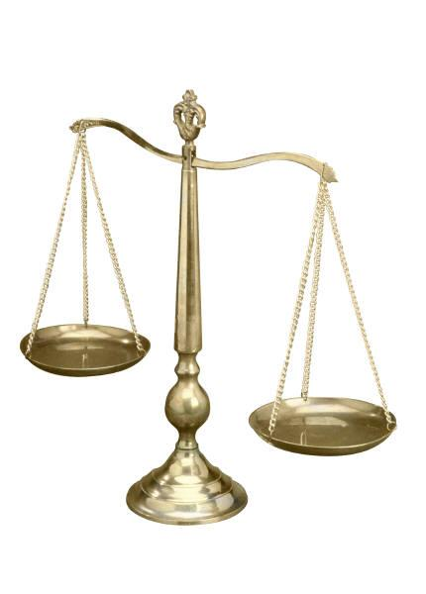
ASK YOUR LEGAL COUNSEL & SUPERVISOR
Always consult with your campus legal counsel and supervisors to ensure you follow federal, state, and local laws.
Notes:
SCOTT –
When it comes to the act of explaining, reframing, or otherwise showing your own understanding of something, for example your Institutions Policy or Procedure, on this and that and that and this, everyone must be on the same page. This will ensure Federal, State and Local Compliance and equally important, a fair and consistent enforcement of the Policy or Procedure when dealing with students.

Slide 5
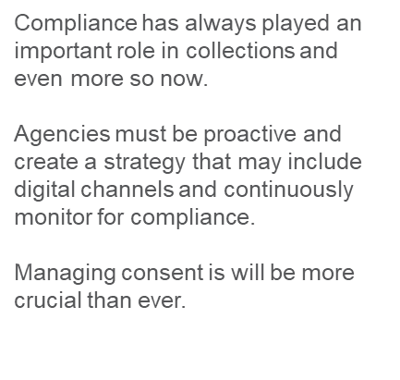
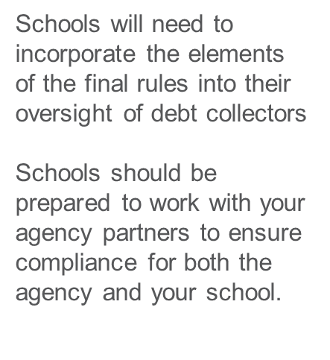
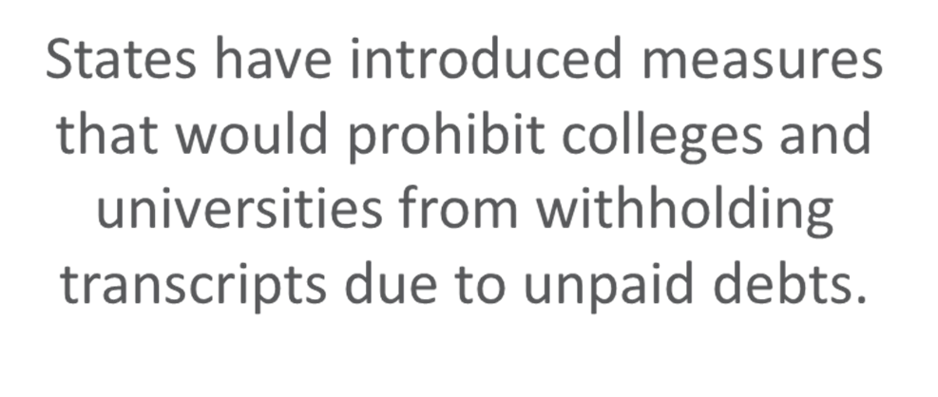
Our Agenda
Notes:
SCOTT –
How’d we get here, it wasn’t my idea. But now that we’re here, what do we do, how do we comply, how do we serve the student and recover our receivables, how do we expand our reach not our staff, how do we improve retention, how do we do what we used to do?
The key word for this slide is STRATEGY and then to make that strategy a documented Policy or Procedure.
I’m talking Starsky and Hutch, Batman and Robin, SpongeBob and Patrick, Tom and Jerry, Bert and Ernie.
Joined at the hip, I’ve got your back, you’ve got mine. The Higher Education landscape is a minefield and we have to navigate this compliance minefield together, it’s the only way we will make it. A true committed partnership, that goes beyond a signed contract.

Slide 6
Notes:
SCOTT –
Run! Run as fast as you can, drink a can of Red Bull and run like you have wings. If you do not have a safe place or cannot reach it, go as high and as far inland as possible, at least 100 feet above sea, avoid fallen power lines and stay away from weakened structures.
Even if you did all that, you can’t escape the Compliance Tsunami.
The legislative landscape surrounding the collection of debt owed to higher education institutions has seen an increase in restrictions on the tools used by institutions to recoup delinquent debt owed by students. Several states across the country have adopted or are considering legislation that:
Prevent schools from withholding transcripts as a means to collect a debt.
Prevent schools from adding the cost/fees of an outside collection agency to the balance owed.
Limit or prohibit the collection of out of statute debt.
So What’s Next –
Tsunami after Tsunami!
Any act deemed abusive under the Consumer Financial Protection Act, CFPB, US Dept of Education will continue to receive the attention and regulation. I expect an increase from State-to-State Regulations as Karen will share in a few slides
I’m expecting Reg 26 – A Regulation for each letter of the alphabet.
Credit Reporting, with recent restrictions on reporting Medical Debt, it has me concerned.

Slide 7
Compliance Alphabet Soup
CFPB
DOE
ECOA – Reg B
FCRA
FDCPA- Reg F
FERPA
GLBA
HEA
HIPAA
PCI 4.0
Red Flag Rules
SCRA
SOL
TCPA
TILA - Reg. Z
UDAAP
1098T
Notes:
KAREN

Slide 8
Hot Topics On Campus
Compliance
CFPB/Unfair, Deceptive, or Abusive Acts or Practices (UDAAP)
Cyber Security and the “Safeguards” Rule
Handling Identity Theft Disputes (Red Flags Rule)
Telephone Consumer Protection Act (TCPA)
Credit Bureau Reporting(FCRA)
Disputes & Validation: Applicable laws – Fair Debt Collections Practices Act (FDCPA) & Fair Credit Reporting Act (FCRA)
SOL & Time-Barred Debt
Collection Costs
Gap Funding
Holding Transcripts
Financial Wellness
Notes:
SCOTT –
When I look at this screen, I think…We need Jesus!
Educational institutions and your agency partners must navigate a complex landscape of compliance requirements, so what do you think is the next, HOT TOPIC that will jump off this slide that may be the next “BIG THING”
Along with these 12 bullet points listed, you can add
Staff turnover
Student Workers, your seasoned experienced veterans are being replaced with Student Workers
Training

Slide 9
How are Laws Created?
Notes:
KAREN

Slide 10
Here is how……………
Regulations
CFPB
DOE
Legislation
Federal
State Law
Judicial – Case Law
Notes:
KAREN

Slide 11
ED’s Negotiated Rulemaking Process
Intent to Establish Committee
Request for Nominations
Rounds of Negotiations
Proposed Rules Published
Comment Period
Final Rules Published by Nov. 1
Effective Next July 1
Public Hearings
Notes:
KAREN

Slide 12
Notes:
KAREN

Slide 13
Final Rules Published this Fall (ED)
Financial Value Transparency + Gainful Employment (9/28/23)
Financial Responsibility (10/31/23)
Certification Procedures (10/31/23)
Ability to Benefit (10/31/23)
Administrative Capability (10/31/23)
All Effective July 1, 2024
Notes:
KAREN

Slide 14
668.14(b)(33) To provide that an institution may not withhold official transcripts or take any other adverse action against a student related to a balance owed by the student that resulted from an error in the institution’s administration of the title IV, HEA programs, or any fraud or misconduct by the institution or its personnel;
668.14(b)(34) To require an institution to provide an official transcript that includes all the credit or clock hours for payment periods in which 1) the student received title IV, HEA funds; and (2) all institutional charges were paid, or included in an agreement to pay, at the time the request is made.
Regulatory Language
Notes:
KAREN

Slide 15
Interpretation
Based on the initial reading of the regulations, it is subject to change.
Notes:
SCOTT –
Interpretation…..
When it comes to the act of explaining, reframing, or showing your own understanding of something, for example your Institutions Policy or Procedure, everyone must be on the same page.
Your Legal Counsel, Supervisors, Decision Makers, Cashiers, Whomever that would engage a student, so that all these folks that have to explain, enforce, and interpret, are all on the same page, repeating the same talking points, walking and talking the same. You have to be 100% consistent when enforcing Policy or Procedure OR you may not be compliant.
What you don’t want to happen is to have the scenario of reading scripture, 100 people can read the same verse, and we’ll have 100 different interpretations. You won’t be in compliance. That is a logistical nightmare, impossible to manage and enforce.
So this may be the perfect opportunity to discuss the question from Tena Flannery from Morehead State University. Her question is a perfect example of Interpretation!!!

Slide 16
Scenario 1
Student receives Title IV, HEA funds for a payment period.
A balance remains for the payment period
The student DOES NOT have a loan or a payment plan in place at the time of the transcript request
The balance is NOT due to an institutional error associated with the administration of title IV, HEA programs and did NOT commit fraud or misconduct
An institution MAY withhold the transcript section associated with the payment period with a balance and/or MAY take another negative action.
The sections of the transcript not associated with the debt MUST be released.
Notes:
SCOTT -

Slide 17
Scenario 2
Student received Title IV, HEA funds for a payment period.
A balance remains for one or more payment periods
The student MAY or MAY NOT have a loan or a payment agreement
The balance is DUE to an institutional error associated with the administration of Title IV, HEA programs AND/OR committed fraud or misconduct
An institution MAY NOT withhold the transcript AND/OR take another negative action.
Notes:
KAREN

Slide 18
Scenario 3
Student received Title IV HEA funds for a payment period.
A balance remains for the payment period
The student DOES have a loan or a payment plan in place at the time of the transcript request
The balance is NOT DUE to an institutional error associated with the administration of Title IV HEA programs and DID NOT commit fraud or misconduct
An institution may NOT withhold the section of the transcript associated with the payment period with a balance and/or MAY take another negative action.
Notes:
SCOTT -

Slide 19
Scenario 4
Student DID NOT receive Title IV, HEA funds for ANY payment period
A balance remains for one or more payment periods
An institution may withhold the entire transcript and/or take another negative action related to the balance owed.
Notes:
KAREN

Slide 20
Scenario 5
Student DOES receive Title IV, HEA funds for a payment period
Account is paid in full for that payment period
An institution CANNOT withhold the portion of the transcript for the courses within the payment period OR any previous payment periods that are paid in full and Title IV, HEA funds were used.
Notes:
SCOTT -

Slide 21
Scenario 6
A student DID NOT receive any Title IV/federal funds for a term and has a balance for the term. However, for previous terms, DID receive Title IV/federal funds, but those terms were paid in full.
An institution COULD NOT withhold a transcript for previous terms that were paid in full and received Title IV funds, but COULD withhold the transcript for the term where they did not use any federal funds, but have a balance.
Notes:
KAREN

Slide 22
Next Steps
Higher Education community to submit feedback to ED
Hopeful for sub-regulatory guidance and clarifications
Schools will need to look at systems and policies
Begin conversations with campus stakeholders
Don’t throw in the towel just yet…
Notes:
KAREN

Slide 23
Your Thoughts Comments
What’s Happening On Your Campus
Changes In Policy and Procedures
Are You In Compliance?
Notes:
ALL

Slide 24
State Laws To Watch
Notes:
KAREN

Slide 25
COHEAO Current State Advocacy
MN bill – HF4100
CA bill – AB 1160
NJ bill - A2121
CO bill – HB 24-1380
Student Loan Equity Act
Clarification on Carve-Outs
Notes:
AB1160 – amendments made and passed Assembly – off to Senate. Now it sits.
Minnesota bill -huge collection debt bill. Andy from ACA said there are a lot of amendments to the bill-including statue of limitations, it is staying at 6 years. Amendments should be out soon. Definition what a debt collector has been removed. COHEAO got a group with ACA to do a sign on opposition.
New Jersey bill 82121: Introduced in January 2024 like the NY bill. Registration of private education lenders. COHEAO keeping an eye on the bill.
CO 24-1380 this Bill does 2 things. First, this Bill will bar a debt collector from pursuing judicial remedies in their own name – essentially barring assignments on all consumer debts – unless the collector becomes a debt buyer. Second, this Bill will prevent debt collectors from having the ability to get a bench warrant in any litigation.
Student Loan Equity Act- Schools after register in state of CO if they service Private Student Loans to CO residents-seeking clarification
To learn more detail on the state compliance issues join COHEAO participate in our bi weekly Advocacy Grass Roots Meetings. See me for details.

Slide 26
State Laws To Watch (Current & Future)
Additional documentation, disclosure, and other collection requirements:
D.C. (B24-357) – Law Passed and Effective August 2022
limits on calls, electronic communications, etc.
New York (A5286) - Private Education Debt Registry Bill- Vetoed Law By the Governor
Required 1st party to register with the state and intensive reporting requirements
New Jersey (A2121)- Introduced January 2024 & Referred to Assembly Higher Education Committee
This bill requires registration of private education lenders and establishes protections for private education borrowers
CO– HB 24-1380
Regulation of Debt-Related Services
Require Collection Agency to buy debt to litigate
MA (S2638)-Rewrote S629
Changing SOL from 6 to 5 years, originally proposed at 3-year
Privacy Laws (15 States)
Ky House Bill 15 Kentucky Consumer Data Protection Act- effective Jan 2026
Others-California, Virginia, Colorado, Utah, Connecticut, Iowa, Indiana,
Tennessee, Montana, Texas, Oregon, Delaware, New Jersey, and New Hampshire
Servicing Laws- licensing or registration requirements
California, Colorado, Connecticut, District of Columbia, Illinois,
Maine, Massachusetts, Montana, New Jersey, New York,
Rhode Island and Washington
Notes:
KAREN

Slide 27
State Transcript Laws
Notes:
KAREN
State Activity
Significant increase interest
13 states have passed laws
Range of impact
8 states debating legislation last year
Some revising existing law
There are several sessions that address transcript withholding: Today at 4:30pm Christina Cardinale and Caleb Rosenburg will be presenting Collecting Student Accounts Post Transcript Laws, and tomorrow there is a session presented by Annamaria Veneziano, and Robert Mirabel titled State or Provate: A Comparative Approach to the Ever-changing Transcript Withholding Regulation.

Slide 28
State Transcript Laws – Enacted
CA – A.B. 1313 – Effective date 1/1/2020
WA – HB 2513– Effective date 6/11/2020
LA – HB 676 – Effective date 8/1/2020
MN – H.F. 6 & 7 – Effective date 7/1/2021
Expires 6/30/24
OH – HB 1110 – Effective date 9/1/2021
OH - New Appropriations Bill includes Private Schools
ME – LD 1838 – Effective date 3/31/2022
CO – HB 1049 – Effective date 4/21/2022
Notes:
KAREN

Slide 29
State Transcript Laws – Enacted
NY – S5924-C – Effective date 5/30/22
IL – SB3032 – Effective date 5/27/22
IN - Bill 404 – Effective date 4/20/23
IL - SB 49 – Effective date 6/9/223 (Amends 2022 law)
CT - SB922 – Effective date 6/9/23
MD - SB0248 – Effective date 7/1/23
OR - SB424 – Effective date 7/1/24
Notes:
KAREN
Newest Law- Oregon
Prohibits post-secondary institutions of education that are based in Oregon from refusing to provide transcript to current or former student because student owes debt to institution. Requires institutions to submit report to Higher Education Coordinating Commission by September 15, 2024, detailing policies relating to providing transcripts and transcript holds] number of current and former students who owe debt to institution and institution's policy and procedures on phasing out transcript holds

Slide 30
State Transcript Laws - Pending
LA HB183 – Introduced in 2022 (prior session)
MA H1277– Reintroduced 1/2023
MN bill - H400-4165 & H40663-Introduced 2024
Extend current Law
MO HB 972 – Reintroduced 1/25/2023
NJ A1198 – Passed House, referred to Senate on 12/2022
S1115 – Introduced in Senate 1/2022 (prior session)
S3548 – Introduced 1/31/2022 – No action
OK B2785 – Introduced 2/8/2023
RI S696 – Introduced 3/22/2023 – Referred Commerce Comm.
TX HB 306 – Introduced 2/2023 – Original bill 11/2020
VA SB159 – Prior Session
HB 732 – Prior Session
Notes:
KAREN

Slide 31
NOW WHAT?
Notes:
SCOTT -
NOW WHAT? My message hasn’t changed….We still need Jesus!
How do we adapt, adjust and overcome?
As restrictions on this practices increase nationwide, institutions will be more hand-cuffed and will be forced to look for other methods to recover delinquent debt. Institutions may want to consider:
Preventing the student from re-enrolling in classes until the delinquent balance is paid.
Placing the delinquent balance with an outside collection agency earlier.
Allowing credit reporting or litigation on delinquent accounts.

Slide 32
Now What?
Higher Education Associations are talking with the CFPB to define "Blanket Policies."
Develop clear and concise policies based on state law
Make sure the policy is transparent
Add policies to FRA's
Avoid policies that create inequitable outcomes
Waiting on further guidance from the department
Develop process and program systems to identify what terms were paid by federal monies
Run it by legal counsel
Notes:
SCOTT –
Documentation is written information that describes and explains a Policy, Procedure, or Service. It can take many different forms, such as Student Handbook, SFRA’s, School Website.
As you read these bullet points, our messaging is to….Develop clear and concise policies and procedures that make it absolutely impossible to be misunderstood and document them. Compliance enforcement must be consistent across the board to all students.

Slide 33
Advocate
Monitor state legislation on both the assembly and senate website
Comment on Proposed Rules
When legislation is introduced, reach out to your administration, legal counsel, public affairs, and other higher education associations
Work with legislators to make the legislation more palatable for all
Review the flagship larger universities policies to strategize on how and if you want to use your political capital
Notes:
KAREN

Slide 34
Resources
COHEAO
FSA PARTNER CONNECT
CFPB
NCM
ACA International
Notes:
KAREN

Slide 35
Notes:
BOTH

