Slide 1
Guess Who’s Coming to Campus?: Gen Z and Their Main Influencers
UK Parent and Family Association
Nicki Jenkins and Nancy Stephens
parents@uky.edu families.uky.edu
Notes:
Welcome!
As we all prepare to welcome new students to campus this summer and fall, we thought it might be a good time to take a look at the newest generation of students who are coming to campus, their traits, their influences, and how we here at UK work to support their biggest influencers – their families.

Slide 2
What are generations?
“A generation is a group of people born around the same time and raised around the same place. People in this “birth cohort” exhibit similar characteristics, preferences, and values over their lifetimes.”
- The Center for Generational Kinetics
“…generations are better viewed as a tool for understanding how perspectives and views change – not as strict categories that define who people are.”
- Michel Dimock, President of Pew Research Center
Notes:
Nicki
First, as we talk about generations it is important to remember that these age groups have been linked together based on their shared larger experiences, such as communication, shopping, and motivation preferences, but that ultimately this is just a larger perspective and does not necessarily depict everyone in that generation. Looking at these trends does help us to modify our strategies to best meet their needs.

Slide 3
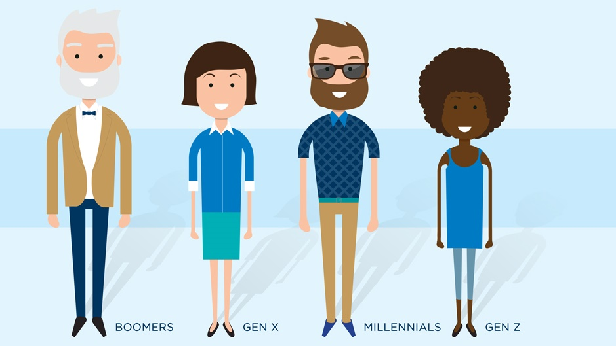
1946-1964
Ages 77-59
1965-1980
Ages 58-43
1981-1996
Ages 42-27
1997- 2012
Ages 26-11
Notes:
Nicki
These are the four current generations in our workforce.
Generational dates often fluctuate based on the source. These are based on the research presented by the Pew Research Center. They considered major events to better define the generations. Generations dates are often also based on location
Baby Boomers were born from 1946 to 1964
Gen X were born from 1965 to 1980
Millennials were born from 1981 to 1996
Gen Z were born from 1997 to 2012.
The coming generation has been coined Generation Alpha and though specific dates have not been established for this cohort, they suggest this group to be people who were born between the early 2010s and mid-2020s.

Slide 4
Baby Boomers
Hard work is the key to success
Competitive
Self-assured
Team-oriented
Communication: In Person
74 million
Notes:
Nicki
Parents of Millennials
Prefer to communicate in person with a handshake and can look someone in the eye.

Slide 5
Generation X
Cynical, skeptical, and pragmatic
Latch key kids
Place great value on time spent with family
Communication: Direct/Immediate
55 million (smallest generation)
Notes:
Nicki
As family dynamics changed and both parents started to go to work, as children they were latch key kids. As a result they place a great value on time spent with family and have passed this along to their children. They seek to play an active and supportive role in their children’s lives.
They do not respect a chain of command as much as boomers. Much more likely to just go to the top, which we will talk about with their parenting style.
They grew up talking on the phone and appreciate direct and immediate communication.

Slide 6
Millennials
Confident with a can-do attitude
Most educated generation
Earliest adopters of social media
Have lived most of their lives with exposure to technology
Communication: Voicemail/Email/Text
62 million
Notes:
Nicki
Also known as the Avocado Toast Generation
Raised by Baby Boomers, Millennials are confident with a can-do attitude.
½ depend on family for financial assistance. Great Recession hit many of them as they were graduating from college or getting started.
They are holding off on starting families to launch their careers, further their education, and practice introspection. Value experiences over things.
1 in 3 have a Bachelor’s degree and many more are going on to graduate school
Even the oldest of the generation have been exposed technology their entire lives and tend to be adaptable to new technology. They are the earliest adopters of social media and suspicious of those without an online presence.

Slide 7
Who is Generation Z?
Notes:
Nicki

Slide 8
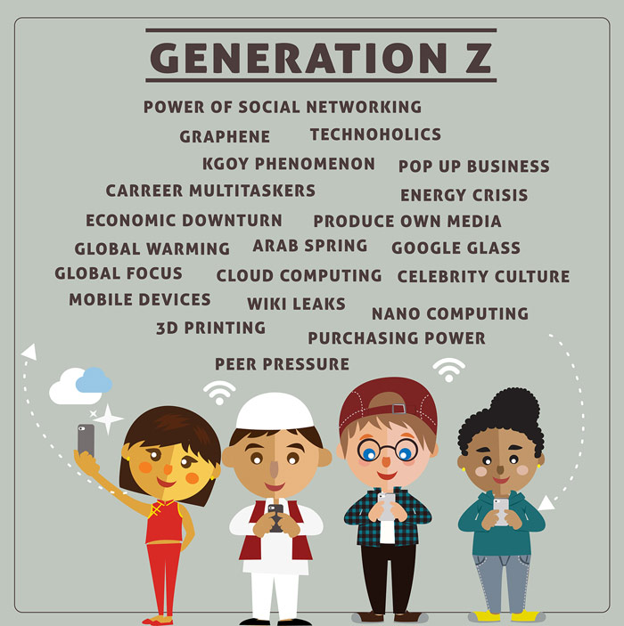
Generational Influences
Technology
War and Conflict
Great Recession
Most Diverse Generation
Notes:
Nicki
The oldest were in kindergarten or pre-school when 9/11 occurred. They were even younger when Columbine High School massacre occurred. Terrorism has always been present. Don’t remember the days when you didn’t have to go through a security line at the airport or could meet a friend or family member at their gate or could carry more than 3.2 oz in a carryon.
Income Insecurity: Great Recession deeply impacted their families, maybe their parents lost a job, or they lost their home. As a result, they are careful where they spend their money and want value. College debt is a huge concern.
Not interested in designer brands just for looks
More access to technology than any other generation. The world and knowledge is at their fingertips
As a result, they are the most diverse and tolerant generation. They can see what is going on in the world.

Slide 9
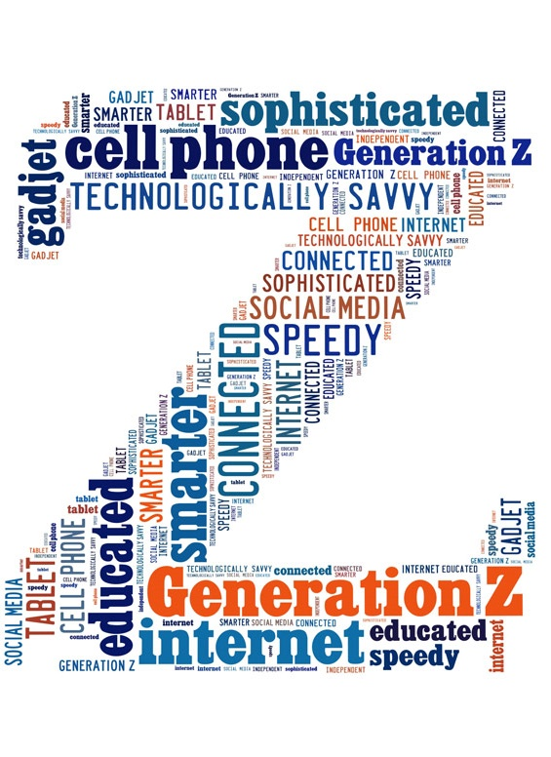
Gen Z Characteristics
Delaying getting their driver’s license
Drinking less alcohol
Postponing sex
Fighting less with their parents
Getting less sleep
Less time with friends
More isolated
More screen time
More depression, anxiety, loneliness, and suicide
Notes:
Nicki
Growing up slower; Not having the adult experiences before they come to college; Emerging Adult a bit slower
Feel insecure, left out and lonely. 31% more 8th and 10th graders felt lonely in 2015 than in 2011, along with 22% more 12th graders
Fewer than half (47%) of Gen Zers say they’re content with their lives compared to 60% of Millennials and 67% of Millennials believe that their life is full of purpose compared to only 53% of Gen Z.
Living dual lives in person and on social media. While they can stay in contact at all times, it doesn’t fix the issue.

Slide 10
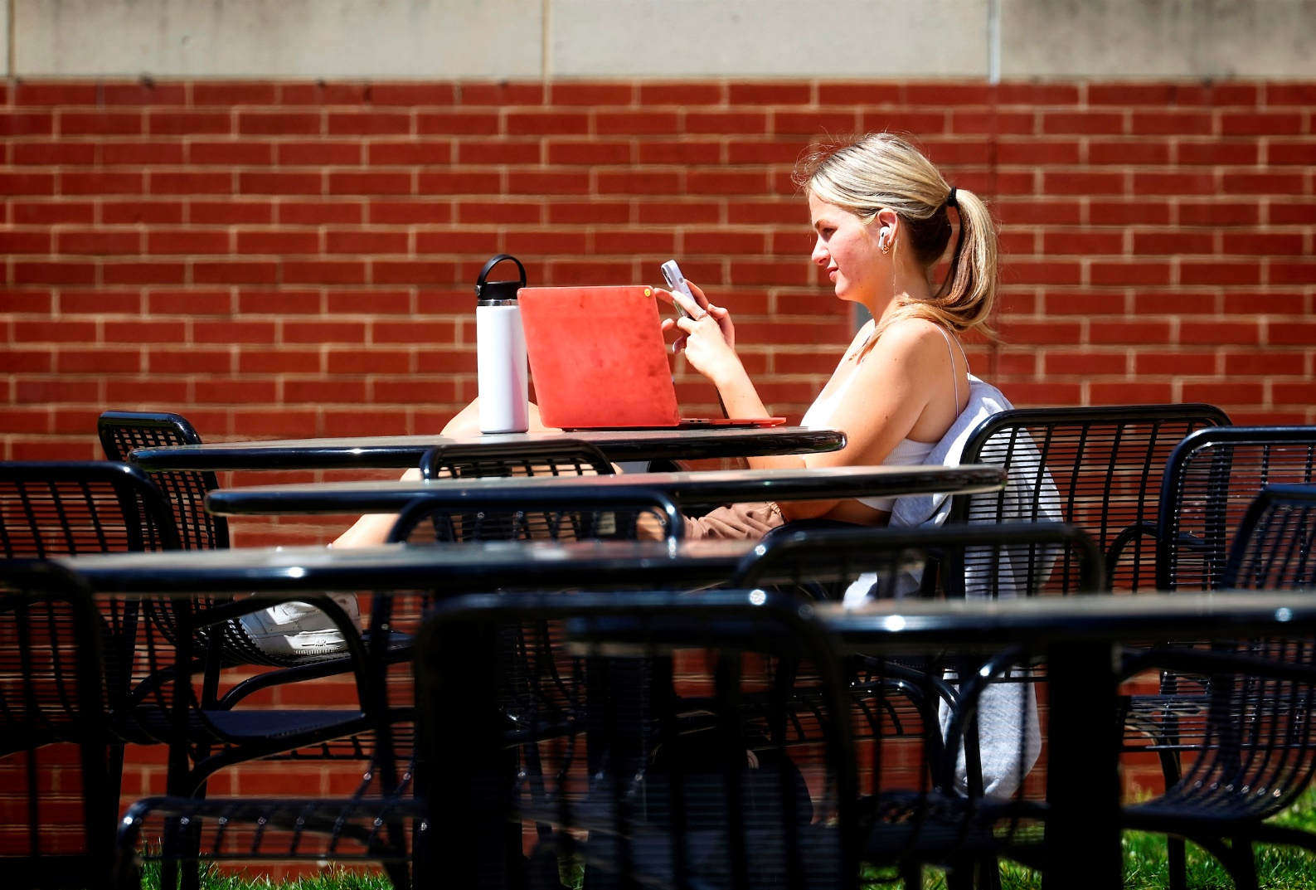
Gen Z Characteristics
Loyal, thoughtful, compassionate, open-minded, responsible
Career minded
Not a job, it’s a passion
Concern for others
Diverse and tolerant
Solution-oriented
Crave predictability and order
Determined
Communication: Text/Social media
Email is ancient technology
Notes:
Nicki
This generation is motivated by social rewards, mentorship, and constant feedback. They also want to be doing meaningful work and be given responsibility. Like their predecessors, they also demand flexible schedules.
Other ways to motivate this generation is through experiential rewards and badges such as those earned in gaming and opportunities for personal growth. They also expect structure, clear directions, and transparency.

Slide 11
Quiz Time: How Gen Z are you?
Notes:
Nicki

Slide 12
1 Point for Answering Yes
In the past 24 hours, did you spend at least an hour total texting on a cell phone?
Do you have a Snapchat account?
Do you think same-sex marriage should be legal?
Were more than 1/3 of the other students at your high school a different race than you?
Do you agree that safe spaces and trigger warnings are good ideas and that efforts should be made to reduce microaggressions?
Are you a political independent?
Do you support the legalization of marijuana?
When you were in high school, did you feel left out and lonely fairly often?
Notes:
Nicki

Slide 13
1 Point for Answering No
Do you consider yourself a religious person?
Did you get your driver’s license by the time you turned 17?
Did you ever drink alcohol (more than a few sips) by the time you turned 16?
Did you fight with your parents a lot when you were a teen?
When you were in high school, did you spend nearly every weekend night out with your friends?
Did you have a job during the school year when you were in high school?
Notes:
Nicki
Tally your score. The higher your score, the more GenZ-like you are (1-14 points)

Slide 14
Who are Gen Z’s main influencers?
Notes:
Nancy

Slide 15
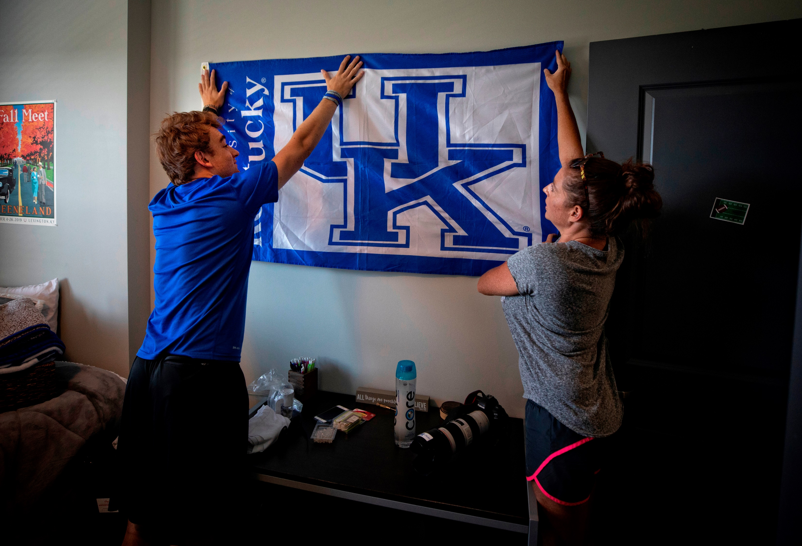
Parents and Families!
Notes:
Nancy
When we talk about parents and families, we are really referring to any supporter in the lives of our students, both parents and family members of origin and of choice.
With students closer than ever to their parents and families, how can we help them help their students?

Slide 16
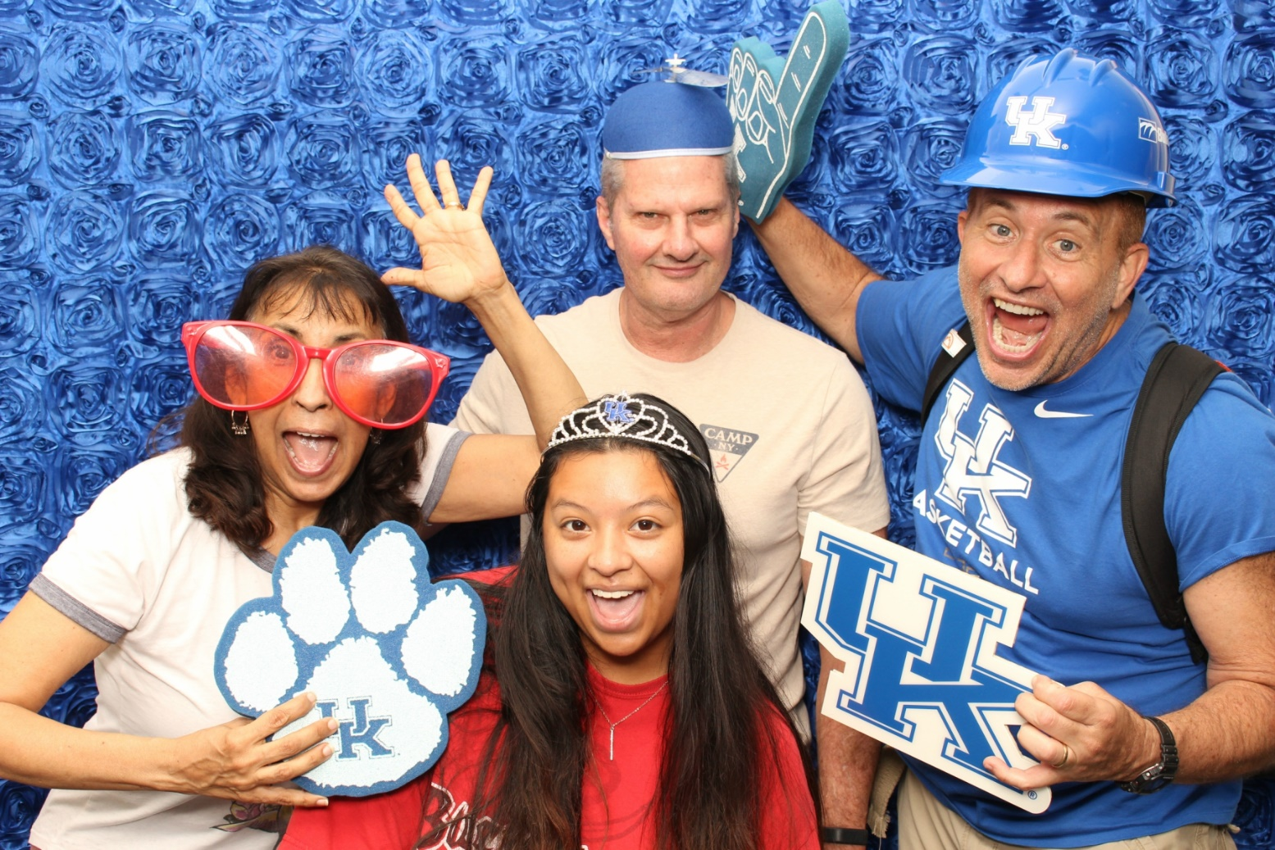
Gen Z Families
Smaller families
Parents as friends
College student parent identity
Concerned with safety and job security
What are some terms that you’ve heard to describe the families of our Gen Z students?
Notes:
Don’t want to have tough conversations
Parents have an expectation that a third party will resolve the issue. Expectation that the University can force their student to do something.
They will go straight to the top to fix the problem
Parent calling about missed exam who referred to them as we
It is all about safety for parents.
“Surveillance” of their students; track their phone, monitor social media, know their friends
With school shootings and crime in general, parents are acutely aware of anything that may hurt their student. As a result, Gen Z tends to not be risk takers and have an expectation of safety.
What are some terms that you’ve heard to describe the families of our Gen Z students? Helicopter, bulldozer, snowplow, Blackhawk, lawnmower
We don’t like that…

Slide 17
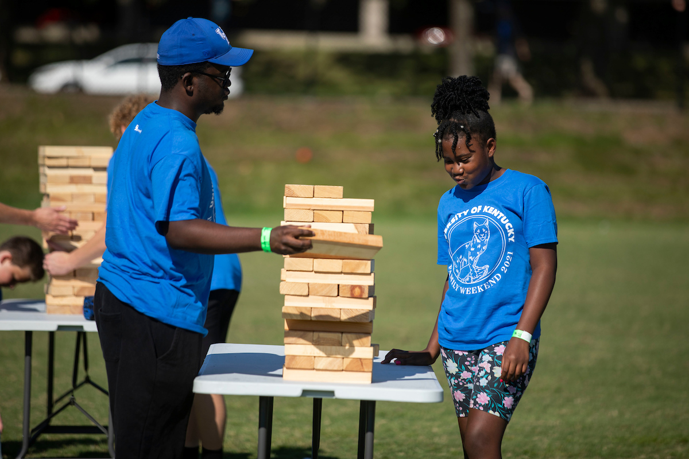
Transition to guiding from the sideline.
Different role for parents and families
Students see parents as their primary role model
Mentoring relationship
Students value family input
Students seek their thoughts and advice
Notes:
Nancy
A better way to see parents and family members is as a co-pilots or coaches with their student.
When we talk to parents and families about this transition, we tell them that as their student begins their transition to college, they will also be transitioning into a new role as “coach.”
It will be time to take a step back and learn to support your student’s problem-solving skills and independence by guiding from the sidelines.
We know that after 17+ years of taking the lead with your student, this new role may feel a little uncomfortable at first.
While it is important for your student to do the work themselves, they will still need your continued support.
When they come to you with a question or a task they aren’t sure how to handle, help them resolve the problem with questions such as:
See questions on screen

Slide 18
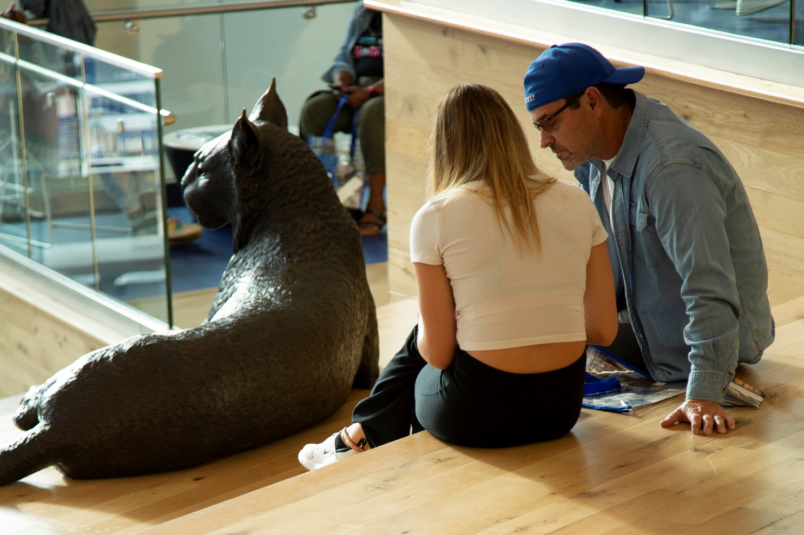
Meeting the Needs of Gen Z Families
Help them understand what their role is and what it isn’t
“Your student should…”
Tangible actions they can help their student with
Individualized approach
“You should…”
Explain the process in detail to manage expectations
Help normalize student behaviors
Involve them!
Notes:
Nancy
Help them understand what their role is, particularly if their student is new to the university and they’re new to supporting a college student
Language matters. Families are often asking what they should do but we generally want their student to be the one to take the next steps with the information you’re providing.
Give them tangible actions they can take to help their student.
Individualize the approach. Help them understand what is going on. They want to know too.
They will not defer to authority, so explain the process to them. If they understand, their student will understand.
We don’t see FERPA as an excuse to not interact with families. While we may not be able to tell them information about their student without the proper release forms, we can still talk them through institutional processes in a general way. While they may not like what we can’t tell them, we can still assist them in getting the answers they need.
Help them understand what college students do. How will they be different. College is not Animal House nor is it the way it was when (if) they went to college.
Particularly for those living at home and first-generation families.
Involve them! Invite them to events, create information just for them on your website or social media.

Slide 19
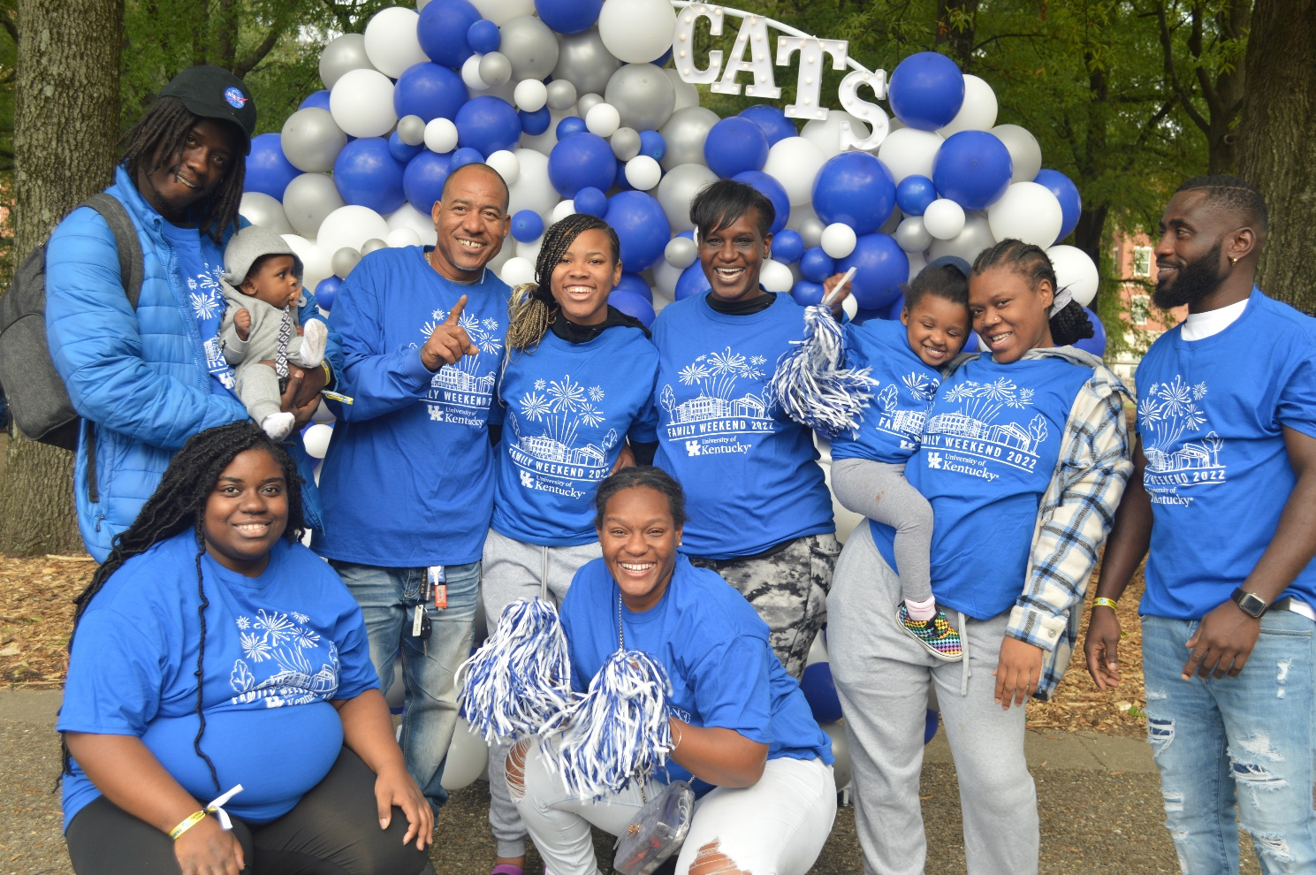
Meeting the Needs of Gen Z Families
Don’t make assumptions about family structure and student support systems
Use inclusive language to encompass as many family structures as possible
Many of today’s families see the stakes as incredibly high for their students and may act/react accordingly
Be empathetic and ask questions
Understand the role of social media and how families are getting information about the university
Partner with the parent/family program on your campus
Notes:
Nancy
Our students’ support systems look different and we need to acknowledge that with inclusive language. We shouldn’t assume a nuclear family structure. Parents and families is our preferred language, never just parents.
Particularly during the pandemic, we have noticed a tendency for families to have big reactions and feelings about things that do not seem consequential. The challenge for us comes in not minimizing their feelings while providing support and information.
Social media has increasingly become a place where families seek information (even when a Google search would get them to the info faster). There are benefits and challenges related to this communication platform. They are building an online support network but not always getting accurate information. When sometimes blows up in a Facebook group, it can be hard to gauge the true extent of the issue (a few loud commenters vs. a lot of mostly happy, silent people).
Your campus likely has a parent/family point person. Make sure you have a relationship with them! They can help communicate things about your office/program/processes to families and let you know what questions they are getting.

Slide 20
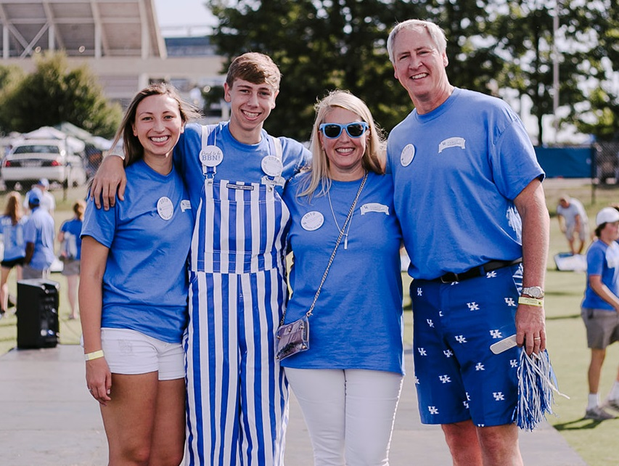
Welcome to the Wildcat Family!
We help families stay connected to UK news and updates!
Open to all parents, family members, and friends
Cat Chat email newsletter and assistance from our staff
Family events and activities
Connect with other UK families
Utilize online resource at families.uky.edu and @UKParents on Facebook, Twitter, and Instagram
Notes:
Nancy
We tell families that part of supporting students is knowing your resources and having your own support system. The Parent and Family Association is here to help.
So, in addition to the many, many resources available to students at UK, the staff who work with the UK Parent and Family Association are your points of contact. We are here to help you navigate the institution, answer questions, and provide as many resources as we can.
Parents and families are wonderful allies as we strive to help students succeed. We share a common goal in wanting your students to be as successful as possible. We realize that this is a time of transition for the whole family not just your college student; and as you are adjusting to your new role . So, the UK Parent and Family Association is here to make your transition as smooth as possible.
The Parent and Family Association is open to all UK parents, guardians, grandparents, and anyone who wants to support a UK student and stay involved on campus. We’re open to all these people because we understand that families come in many different forms, so please understand that any time we say parent we use that term to indicate any person in the student’s support system, not just a biological mother or father.
The University communicates with families through the Parent and Family Association using the contact information your Wildcat provided on their application for admission to UK. Additional family members can join by visiting our website to provide their contact information. We want to make sure you have all the information you need to support your student and be in-the-know with what is happening on campus.
There are a number of ways we will provide support. Our most popular service is our Cat Chat email newsletter. Emails are sent several times a month during the school year with information on campus events, advice for parents, and important date reminders. Just as UK will communicate with your students through their UKY email, families receive communications from us through Cat Chat so you can anticipate that as we head into the fall.
We also support families through hosting special events for parents and families during K Week, and we coordinate the university’s annual Family Weekend celebration. We will talk more about Family Weekend in a moment. But these are great opportunities for families to be a part of your student’s college experience.
As you preparing your student to come to college, we encourage you to bookmark our website and follow us on Facebook, Twitter, and Instagram. Both are great ways to get more information about what’s going on at UK.

Slide 21
Nicki Jenkins and Nancy Stephens
Email: parents@uky.edu
Phone: 859-257-2752
Website: families.uky.edu
Facebook, Twitter, Instagram: @UKParents
Notes:
Contact information
This summer will go fast. There is a lot to do and a lot to balance.
Remember, even during the difficult moments, that you will miss your student.
Make the most of your time together. Be patient and understanding. Be excited about everything your student is about to experience and the ways in which they will grow. Remember to use your sense of humor! Make sure they hear your excitement and let them know they will be missed.
Finally, remember that it isn’t just your student experiencing a transition, but you and other family members as well.
Thank you for joining us today! A special thanks to XX for sharing their perspective as a parent of a current UK student and to our fantastic student leaders for sharing their experiences being students at UK.
Your students should be returning soon from their college meetings and will be meeting you in the hall outside of the cinema. We will be here at the front for a little while if you have any additional questions, or you can email me at parents@uky.edu and I will be happy to answer your questions. Stop by the VC with additional questions until 1 p.m.
Once again, congratulations to you and your new Wildcats! We look forward to seeing you again at either a Merit Day or Big Blue Nation Orientation, and in the fall!

Slide 22
Sources
Bray, L. (2020, March 17). Guess Who’s Coming to Campus?! Understanding Generation Z and Their Main Influencers. Parent and family admitted student day presentation, Memphis, TN.
Dimock, M. (2019, January 17). Defining generations: Where Millennials end and Generation Z begins. Retrieved April 20, 2023, from https://www.pewresearch.org/fact-tank/2019/01/17/where-millennials-end-and-generation-z-begins/.
Seemiller, C., & Grace, M. (2016). Generation Z Goes to College. San Francisco, CA: Jossey-Bass.
Twenge, J. M. (2017). iGen: Why Today’s Super-Connected Kids Are Growing Up Less Rebellious, More Tolerant, Less Happy – and Completely Unprepared for Adulthood – and What That Means for the Rest of Us. New York: Atria Books.
Twenge. J. M. (2018, March 8). iGen: The Smartphone Generation. TEDxLangunaBlancaSchool. Retrieved from https://www.youtube.com/watch?v=UA8kZZS_bzc.

