Slide 1
The Necessity of DEIB in Higher Education
Dr. Dawn Offutt
Executive Director for Access, Engagement, and Belonging
Kentucky Council on Postsecondary Education

Slide 2
Touch Points
Rationale
Common Ground
Benefits
What Can We Do
How Do We Start

Slide 3
Why are diversity, equity, inclusion, and belonging a necessity in higher education?

Slide 4
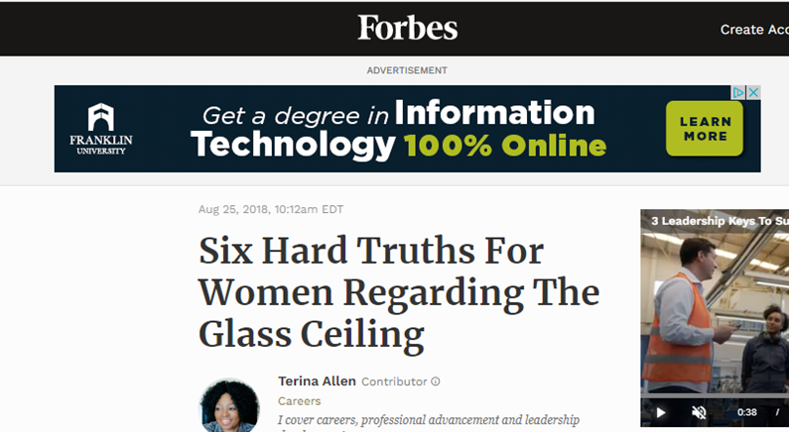
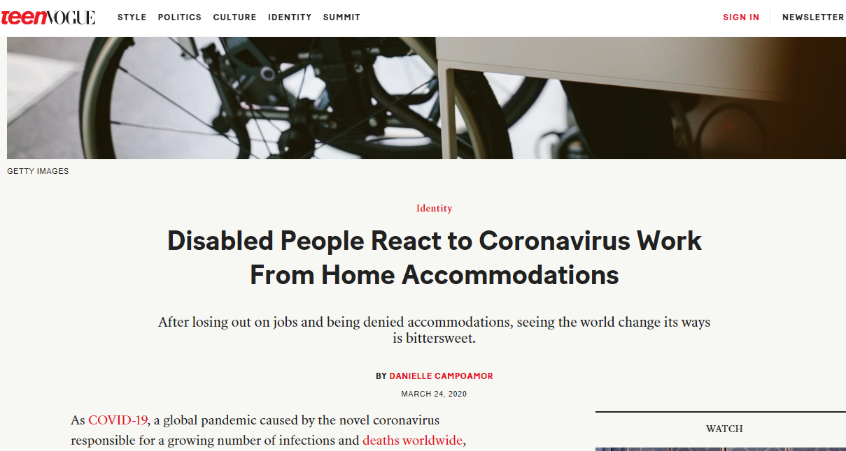
Rationale

Slide 5

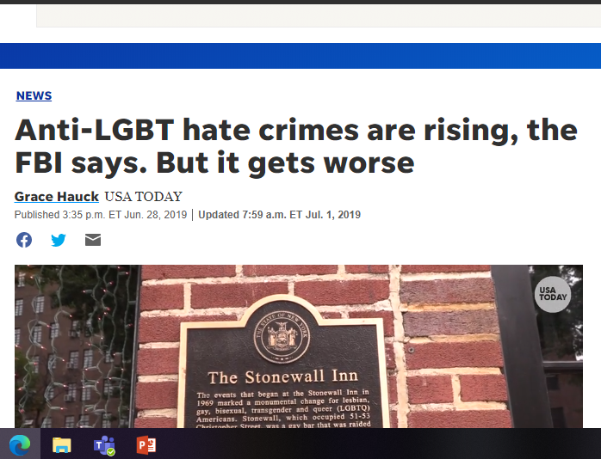
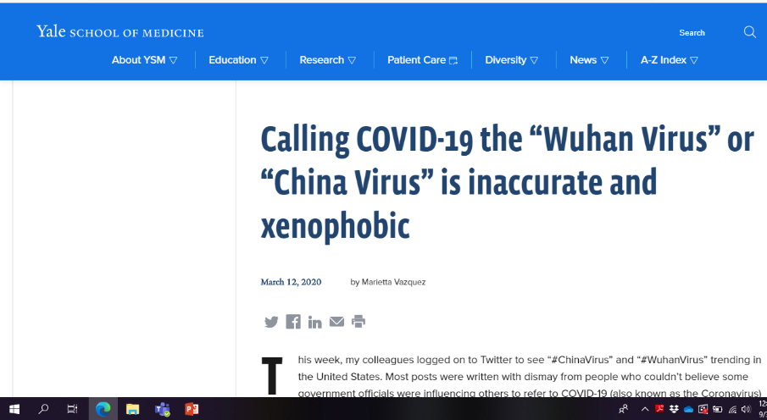
Rationale

Slide 6
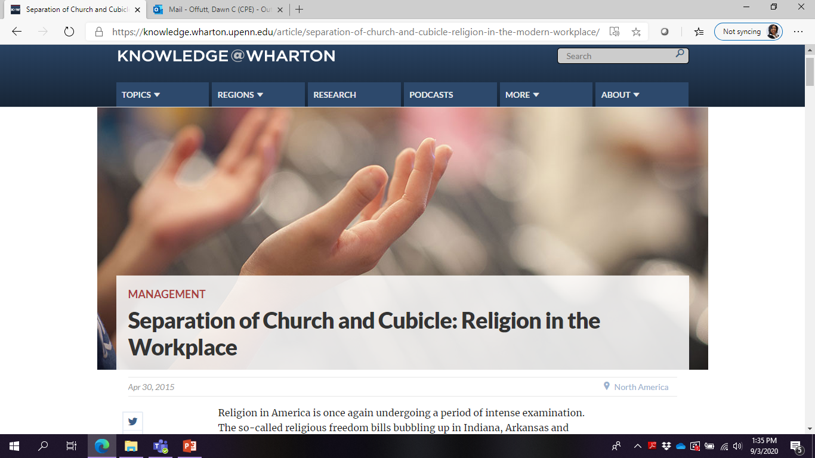
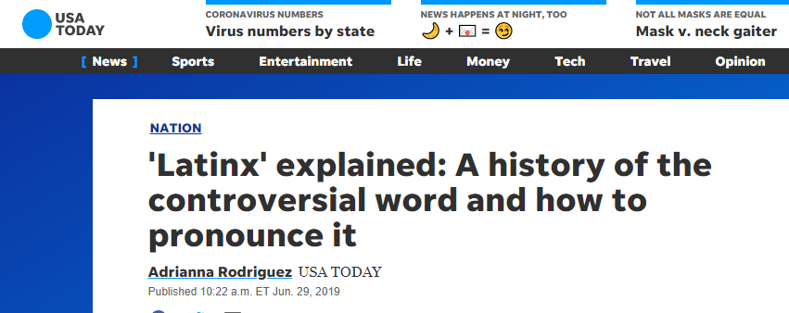
Rationale

Slide 7
Why are diversity, equity, inclusion, and belonging a necessity in higher education?

Slide 8
What is the percentage of diversity among students at Kentucky’s public postsecondary institutions?
A. 32%
B. 26%
C. 17%
D. 8%
E. Other

Slide 9
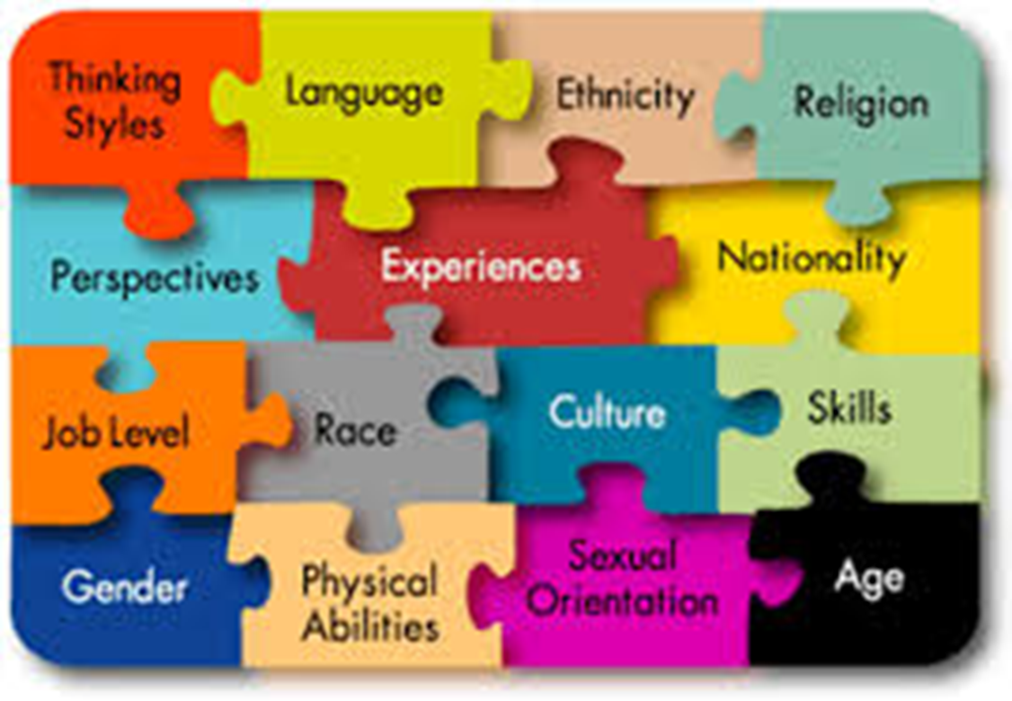
What is “Diversity”?
Diversity - People with varied human characteristics, ideas, world views, and backgrounds. Diversity in concept expects the creation by institutions of a safe, supportive, and nurturing environment that honors and respects those differences.

Slide 10
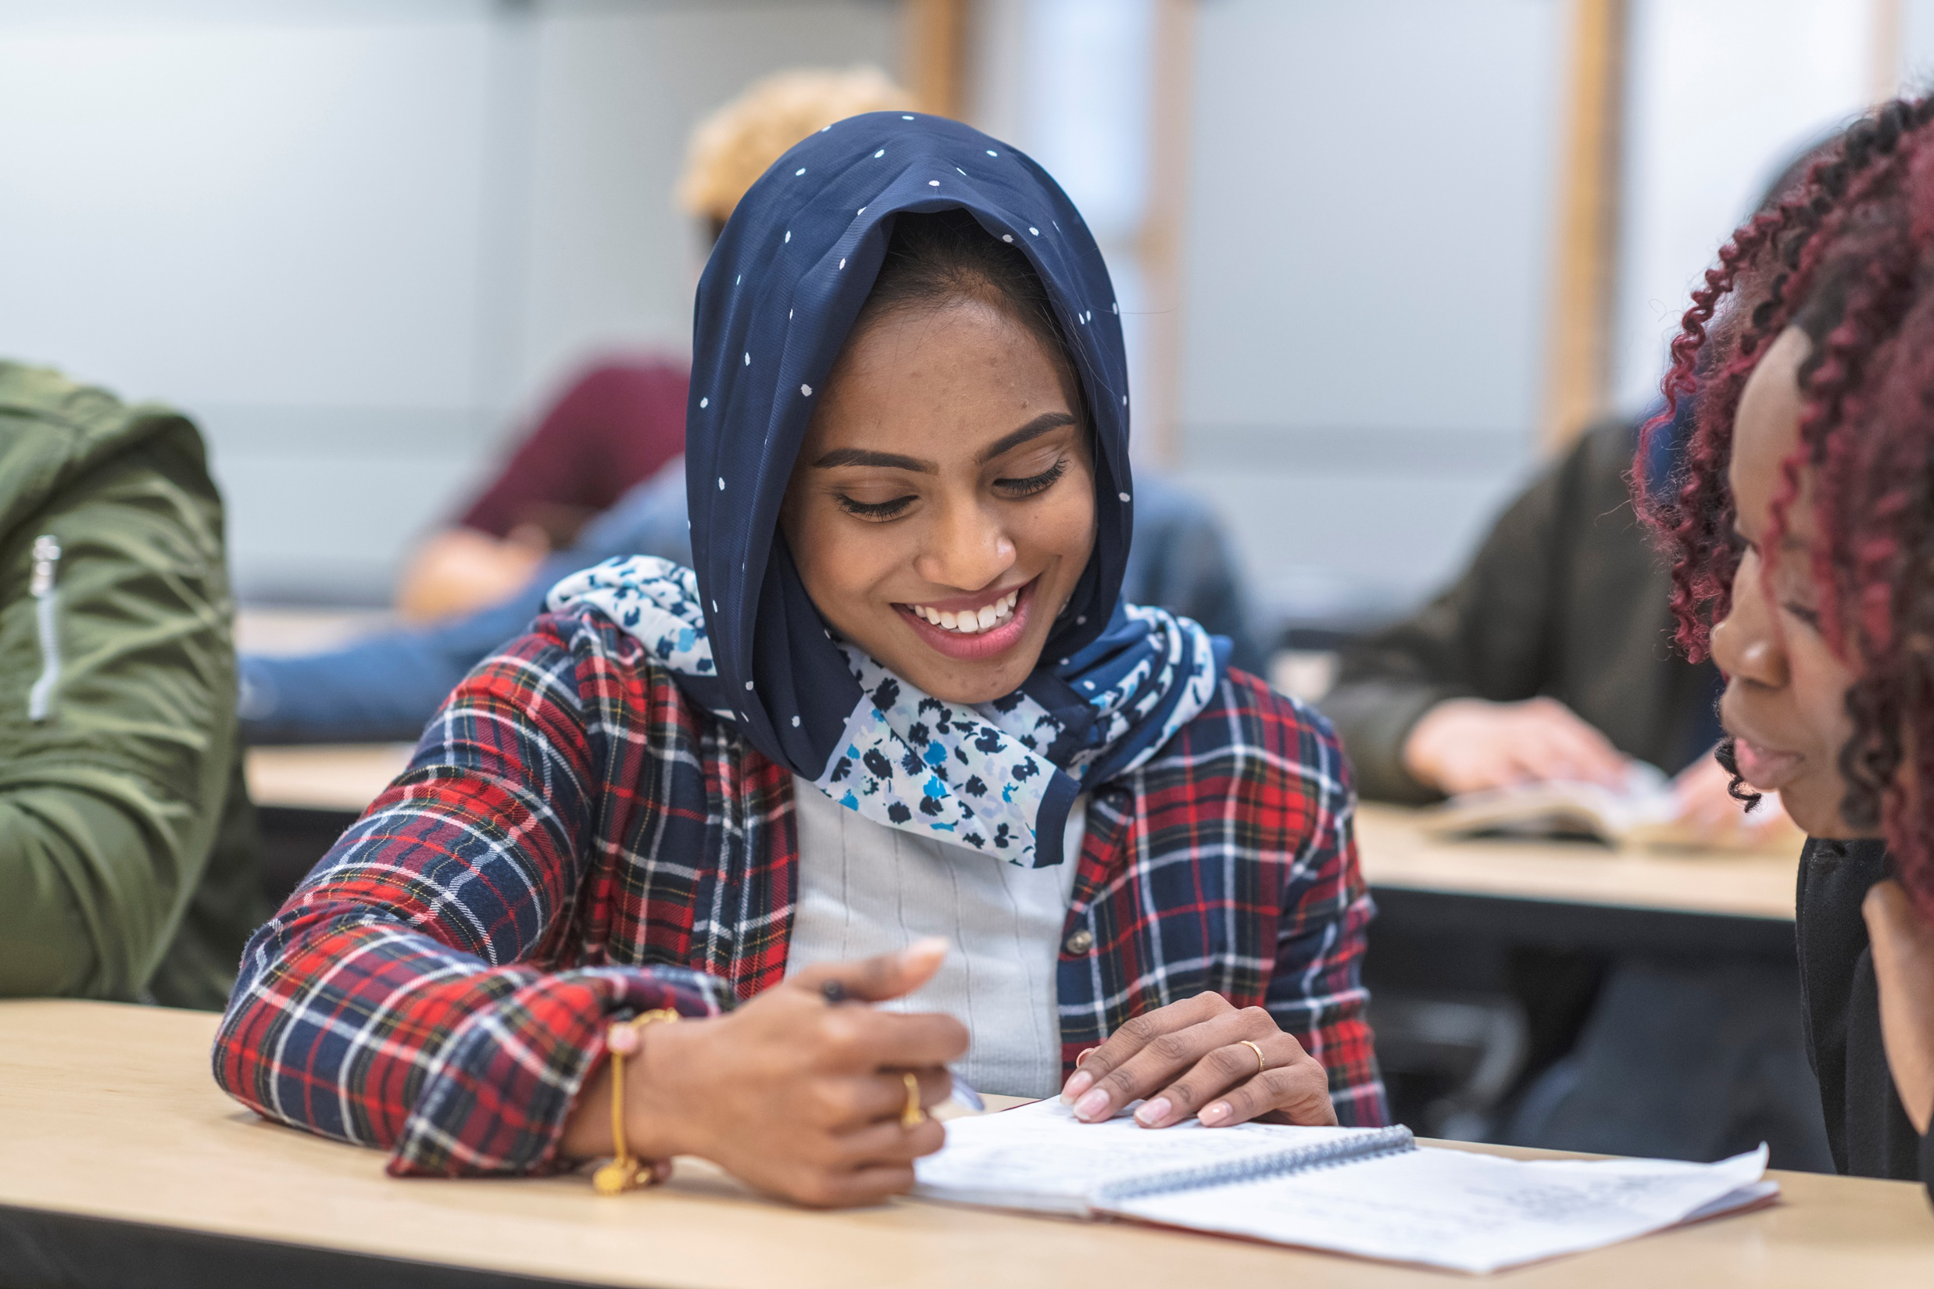
What is “Educational Equity”?
Educational Equity - the idea that every student should have access to the necessary resources to reach their full academic potential.

Slide 11

What is “Inclusion”?
Inclusion - The active, intentional, and ongoing engagement with diversity—in the curriculum, in the co-curriculum, and in communities (intellectual, social, cultural, geographic) with which individuals might connect—in ways that increase awareness, content knowledge, cognitive sophistication, and empathic understanding of the complex ways individuals interact within systems and institutions.

Slide 12
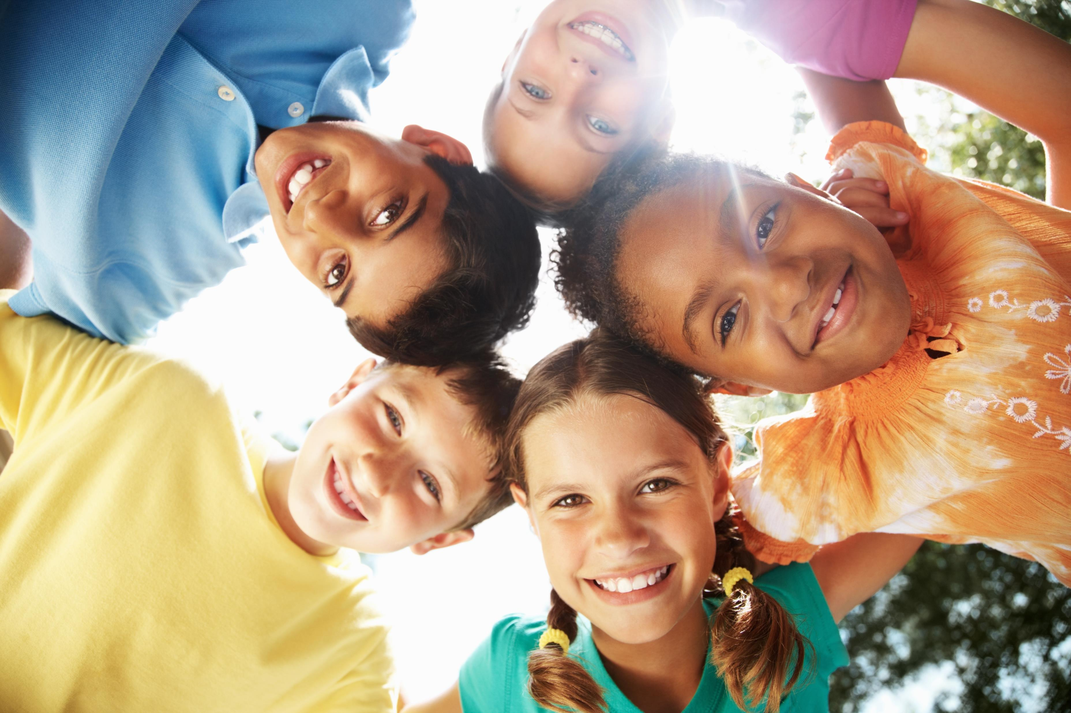
What is “Belonging”?
A feeling that members (of a group) matter to each other and to the group

Slide 13
Why are diversity, equity, inclusion, and belonging a necessity in higher education?

Slide 14
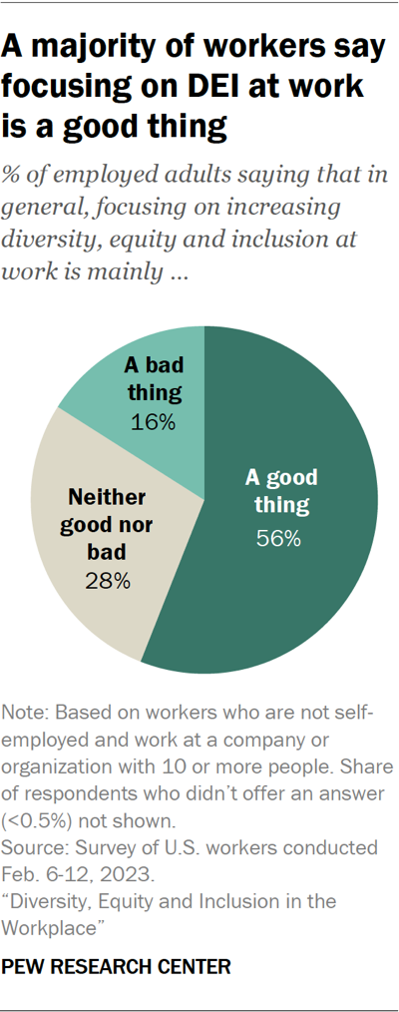
Benefits of Diversity, Equity, and Inclusion
Inclusive environments foster a sense of belonging; employees feel respected and valued for their unique contributions.
Boosts morale, satisfaction, and engagement, which increase retention and reduces turnover.
Organization benefits from a broader range in talent.

Slide 15
Benefits of Diversity, Equity, and Inclusion in Campus Settings
Diversity Improves Cognitive Skills and Critical Thinking
Diversity Prepares Students for Global Citizenship
Diversity Promotes Creativity and Innovation
Equity Ensures All Students Have What They Need To Succeed
Inclusion Promotes Ownership and Accountability

Slide 16
Benefits of Belonging in the Campus Setting
Negative behavior incidences diminish.
Academic achievement improves.
Students feel more connected to faculty, staff, and peers.
Students are more engaged in clubs and organizations.
Belonging leads to higher retention and graduation rates.
Students feel free to be themselves.
Notes:
Why a sense of belonging at school matters for K-12 students - Qualtrics

Slide 17
Why are diversity, equity, inclusion, and belonging a necessity in higher education?

Slide 18
Diversity in the Campus Setting - What Can We Do?
Learn about Students’ Cultural Backgrounds
Create a Culturally Responsive Learning Environment
Allow Students to Learn about Their Community
Establish a Zero-Indifference Negative Behavior Policy
Incorporate diversity in your lesson plans.
Give your students freedom and flexibility in their educational lessons.
Acknowledge and respect every student.

Slide 19
Equity in the Campus Setting – What Can We Do?
Addressing resource allocation by ensuring equal access to funding, technology, and educational materials
Providing targeted support, interventions, and assistance to students who are at risk of falling behind
Utilizing data to identify disparities in performance and determine what interventions are most urgently needed
Diversify and differentiate the curriculum/ Accommodate different learning styles
Embrace flexibility by using multiple modalities, diversifying assessment approaches, and mixing up classroom seating arrangement to accommodate students in need of social support and collaboration.
Diversify and Differentiate the curriculum by recognizing students’ differences—in learning style, knowledge base, language skills, culture, physical ability, and offer a wide variety of instructional and assessment techniques tailored to their unique needs.

Slide 20
Inclusive Campus Settings – What Can We Do?
Build an authentic relationship with each student for the foundation of a truly inclusive classroom.
Know what motivates students to learn and the styles of learning that work best for them.
Setting clear expectations for the classroom culture and having students participate in the development of those expectations help promote a positive learning environment in which everyone is invested and held accountable.
Provide a range of materials and activities that supports all students’ learning styles, incorporates a variety of cultural backgrounds and perspectives, and fosters courageous thinking.
Offer a range of both academic and non-academic resources to all students and to their parents and guardians in multiple languages.
Collaborate with and have the support of all members of the school community.

Slide 21
Belonging in the Campus Setting – What Can We Do?
Add social emotional learning skills like social awareness and relationship-building into curricula and programming
Ask students (as well as faculty and staff) to reflect on their sense of belonging can give you the feedback you need to understand what is or isn’t working.
Cultivate competencies, opportunities, motivations, and perceptions for students to increase their sense of belonging

Slide 22
Toward Cultural Competence

Slide 23
Cultural Competence
An ability to interact effectively with people of different cultures.
A culturally competent individual:
Has an awareness of one’s own cultural worldview;
Possesses knowledge of different cultural practices and worldviews; and
Possesses cross-cultural skills to better interact with those from other cultures.
Policies and practices at the organizational level and values, beliefs and behaviors at the individual level that enables effective cross cultural interactions among employees, clients, and community.

Slide 24
Cultural Competence Is…
INDIVIDUAL
The ability to effectively relate to, learn from, and collaborate with people from diverse cultural backgrounds.
ORGANIZATIONAL
The ability to successfully integrate the many individual cultures that exist within it.
Notes:
If an organization has been actively working toward equity, diversity, and inclusivity, many different cultures and backgrounds should be represented at every level of the organization. Cultural competency ensures that employees of various perspectives are heard on a regular basis.
Cultural competence is the ability to shift cultural perspective and adapt one’s behavior to cultural similarities and differences. Simply put, it means recognizing that you have a culture and that this culture impacts your worldview. After this realization, you must learn to see events from the perspective of those that are different than you.

Slide 25
Rationale for Cultural Competency
Demographic shifts and an increasingly diverse population.
Societies are becoming globalized.
Persistence of issues around cross-cultural contact, discrimination, and related challenges.
By 2030, children of color will constitute over half of students in U.S. schools.
The National Education Association reports that 2014 was the first year in which the majority of students in American public schools represented racial and ethnic minorities. In addition, the Southern Education Foundation found that in 2013, a full 51 percent of public school children were from low-income families.
Continued disproportional representation in racial ethnic and socioeconomic groups in achievement, discipline and drop-out rates.
Being good at your job is more than getting through a list of tasks, but also about being able to demonstrate key behaviors in different situations.

Slide 26
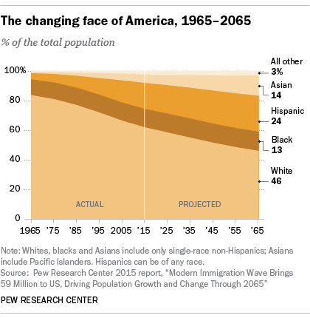
Rationale for Cultural Competence
Demographic shifts and an increasingly diverse population.

Slide 27
Benefits of Cultural Competency
Increases respect and mutual understanding among those involved.
Increases creativity in problem-solving through new perspectives, ideas, and strategies.
Increases participation and involvement of other cultural groups.
Increases trust and cooperation.
Helps overcome fear of mistakes, competition, or conflict.
Promotes inclusion and equality.
Limits microaggressions.
Notes:
Discuss the similarities to True Colors and how there is a benefit to having diverse perspectives and that everyone should not be like minded.

Slide 28

Soda
Pop
Coke
Other

Slide 29
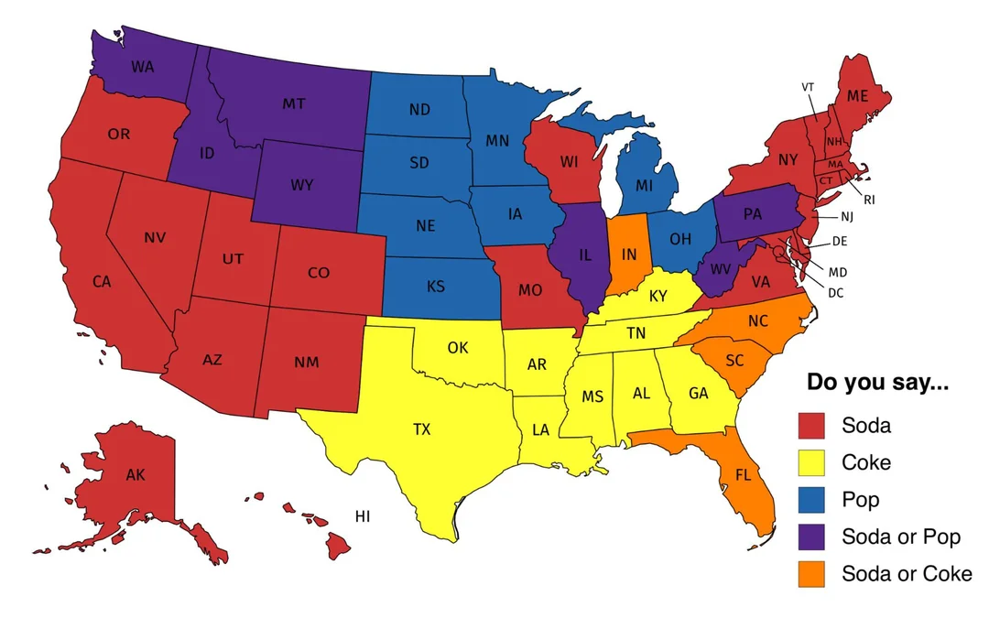
Soda vs.
Pop vs.
Coke

Slide 30

Cultivating a Cultural Competence
A4 Model for Cultural Competence

Slide 31
Cultural Competence Is…
INDIVIDUAL
The ability to effectively relate to, learn from, and collaborate with people from diverse cultural backgrounds.
ORGANIZATIONAL
The ability to successfully integrate the many individual cultures that exist within it.
Notes:
Cultural competence is the ability to shift cultural perspective and adapt one’s behavior to cultural similarities and differences. Simply put, it means recognizing that you have a culture and that this culture impacts your worldview. After this realization, you must learn to see events from the perspective of those that are different than you.
If an organization has been actively working toward equity, diversity, and inclusivity, many different cultures and backgrounds should be represented at every level of the organization. Cultural competency ensures that employees of various perspectives are heard on a regular basis.

Slide 32
Cultural Competence Is…
An ability to interact effectively with people of different cultures.
A culturally competent individual:
Has an awareness of one’s own cultural worldview;
Possesses knowledge of different cultural practices and worldviews; and
Possesses cross-cultural skills to better interact with those from other cultures.
Policies and practices at the organizational level and values, beliefs and behaviors at the individual level that enables effective cross cultural interactions among employees, clients, and community.

Slide 33
A4 Model for Cultural Competence
Notes:
Increasing effectiveness in relating across cultural differences in increasingly diverse environments.

Slide 34
Awareness
Goal: Through on-going self-reflection, individuals will develop a better understanding of who they are, become more aware of human diversity and demonstrate a respect for the dignity of others.
Learning Outcomes:
To define and differentiate key terms related to diversity
To increase self-awareness by defining one’s own identity and comparing/contrasting one’s identity with others
Who am I?
Who are the staff with whom I work?
Who are the people that I serve?

Slide 35
Acknowledgment
Goal: Through on-going self-reflection, individuals will recognize that power and privilege influence relationships on interpersonal, intergroup, and institutional levels and consider how they may have or have not been affected by those dynamics.
Learning Outcomes:
To discuss how our identities impact those with whom we interact
To define intersectionality and explore how our identities are influenced by several cultural categories
To explore the concept of privilege and acknowledge our individual privileges
How am I?
How do my social/cultural groups intersect?
How am I the same as those with whom I work? How do I differ?
How am I the same as the people that I serve? How do I differ?
What implications does this knowledge have on the work that I do?

Slide 36
Acceptance
Goal: Through on-going self-reflection, individuals will demonstrate a continual openness to ideas, beliefs, and practices that challenge their own worldview and moves them to embrace a broader perspective.
Learning Outcomes:
  To identify one’s personal biases and how they shape one’s worldview
  To explore the concept of microaggressions and how they can impact members of different cultural groups
  To explore opposing views that challenge one’s assumptions and beliefs (e.g., demographics, religion, politics)
Why am I?
What messages did I receive about people who are like me? Not like me?
How have these messages impacted how I interact with those different than me?

Slide 37
Action
Goal: Through on-going self-reflection, individuals will be able to communicate in ways that indicate an acceptance of and appreciation for individuals different from themselves and recognize their own responsibility in leading and promoting equity and justice in a global society.
Learning Outcomes:
  To authentically express one’s individual experiences that honors self without condemning others
  To effectively communicate within and across cultures to foster and sustain open dialogue and navigate difficult conversations
  To develop a plan that integrates awareness, acknowledgment and acceptance into a model of action that identifies next steps for leading and promoting justice in a global society.
What knowledge/skills do I need to effectively work with those different than me?
How can we be intentional about successfully integrating the many individual cultures that exist within our organization?
How do I/we plan to put this knowledge/skills into action?
How will I/we know when I/we have been successful?

Slide 38
Next Steps
Assess your diversity, equity, inclusion, and belonging efforts.
Determine your ability/capacity/willingness to see/do things in a different manner.
Find places where diversity, equity, inclusion, and belonging practices can intentionally be increased or implemented.

Slide 39
Freedom is gained by appreciating difference and finding common ground.”
Thank you!

