Slide 1
Navigating the “Cliff”: Embracing a “Student-Ready” Mindset
Dr. Michael J. Marshall Vice President for Enrollment, Marketing and Communication
Bellarmine University
2024 KASRO Annual Conference
Louisville, KY
Monday, April 29, 2024
2:30PM

Slide 2
Session Overview
Introduction
Adapted Marketing Pressure Framework
Learner Profile and Demographic Cliff/Shift
“Student-Ready” Strategies and Calls to Action
Case-Study Exercises
Questions/Open Dialogue
Wrap-up

Slide 3
Four Market Pressure Points/Framework
Accessibility | Affordability | Accountability | Sustainability
Who will have access to college? This is the convergence of demographic, economic, technological, political, and market forces | How will students pay for it? Who can afford college, especially given the demographic shift? | What outcomes should be expected of institutions? Why is a college education worth the investment? | What resources will your institution provide to enhance quality and maintain access? How will this be done, even when these may be perceived as competing/conflicting goals?
Source: Adapted from Breakpoint: The Changing Marketplace for Higher Education (McGee)

Slide 4
Profile of Today's Learner
52%
28%
First Generation
Caretaker (Children or Dependents)
51%
26%
Low to Moderate Income
Full-Time Employment While Enrolled
44%
18%
Age 24+
Non-Native English Speaking
42%
10%
From a Community of Color
Immigrant
30%
5%
Enrolled Part-Time
Active-Duty Military or Veteran
Source: Becoming a Student-Ready College

Slide 5
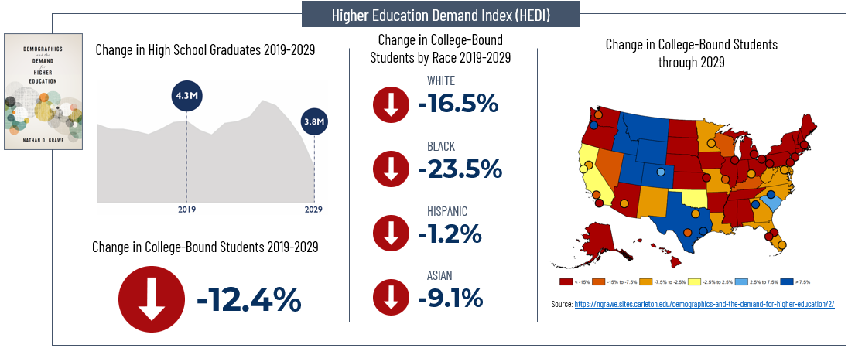
Demographic Shifts 2019-2029 Nathan Grawe’s Higher Ed Demand Index
Source: Nathan Grawe, Demographics and the Demand for Higher Education, 2017 via MarketView

Slide 6
Macro KY High School Graduate Trends
Pre-pandemic projections for KY showed a 10% increase in 2-year college students and a 20% increase in 4-year college students by 2023.
However, by 2029, both 2- and 4-year college projections are expected to decline by 25% relative to 2023.
Currently, 75% of students attend 2 and 4-year colleges, with 43% at 4-year institutions and 32% at 2-year institutions.
The median household income in KY is $47K, with 54% of households earning less than $50K per year.
Source: EAB

Slide 7
Segmented KY High School Graduate Trends
From the KY HS Graduating Class of 2021 to the Graduating Class of 2026, the demographics are projected to shift as follows:
10.9% increase in overall number of students (48K to 53K)
14.3% increase in African American/Black
43.4% increase in Hispanic or Latino
61.5% increase in Two or More Races
30.4% increase in Economically Disadvantaged
53.7% increase in Students with Disabilities (IEP)
-14.5% decrease in Gifted and Talented
19.0% increase in Houseless Students
*Peak enrollment is Class of 2024 at 55K
Source(s): KDE School Report Card 2021/ AIKCU

Slide 8
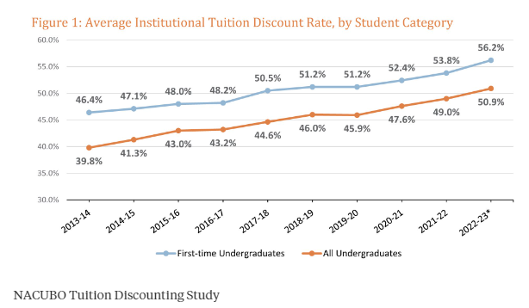
Tuition Discount Rates Reach Unprecedented Levels
First-year (FY) discount rate has increased nearly 10% over the last decade.
Since the onset of the pandemic, FY discount rate has grown more than 5%.
The discount rate for all undergrads (UG) has increased slightly more than 10% over the last decade.
Since the onset of the pandemic, UG discount rate grew 5% over the last decade.
Net tuition and fee revenue decreased by roughly 5% for FY.
Net tuition and fee revenue dropped by nearly 6% for all UG.
Source: NACUBO

Slide 9
Demographic Cliff/ Shift Drivers Summary
Declining Birth Rates
Change in Migration/Immigration Patterns
Shift in Family Dynamics/Composition
Workforce Demand
Alternative/Technological Education Models
Shifting Attitudes toward College

Slide 10
Strategies/Calls to Action
Segment and Analyze Data viewed through Equity Prism
Educate and Train Campus Community
Connect Students with Community Resources
Enhance Visibility of Financial and Employment Options
Perforate Administrative Silos
Ensure Availability of Emergency Funds
Conduct a Student Journey Audit
Re-examine Institutional Billing/ Debt Policies

Slide 11
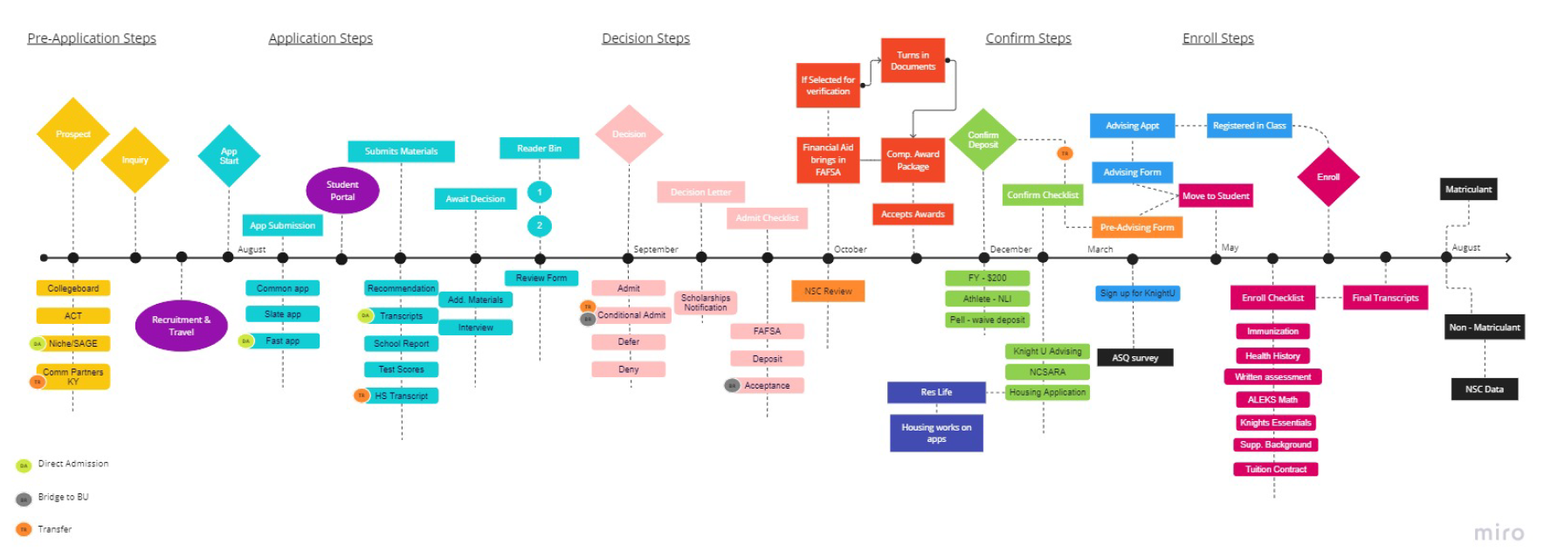
Student Journey Map (example)

Slide 12
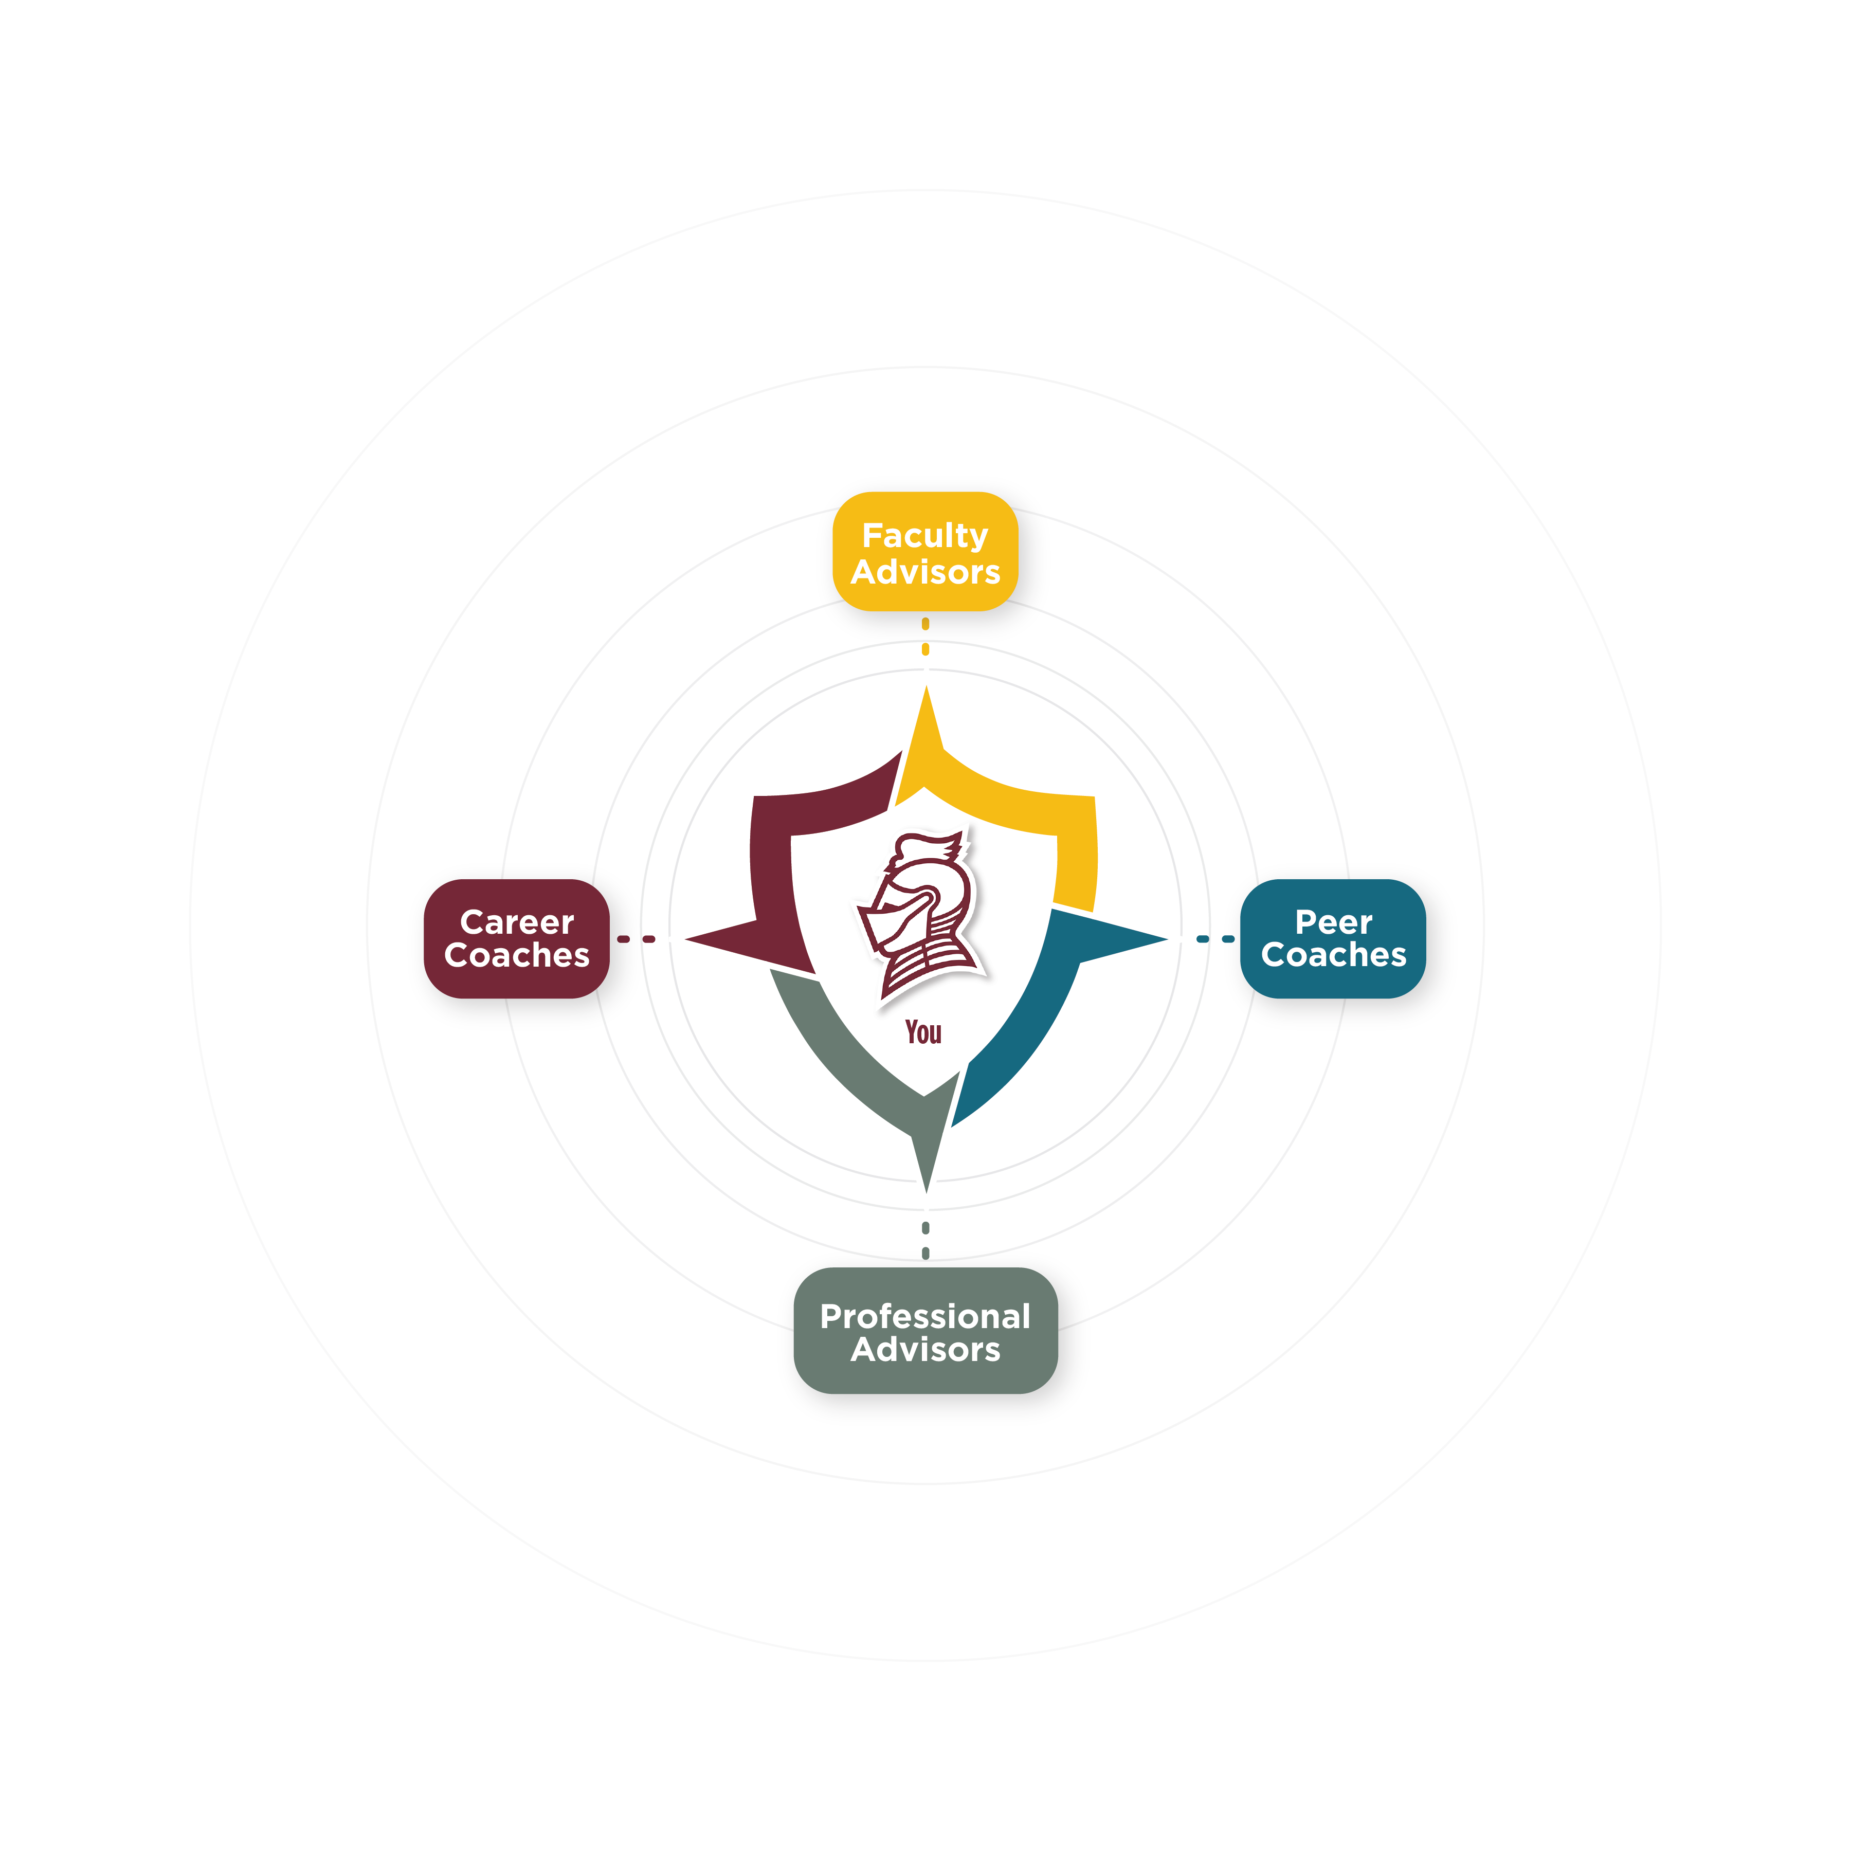
Inspiring Meaningful Personal, Academic and Career Transformation

Slide 13
Case Study: Aid Disbursement and Billing Misalignment
At Alignment University, students have reported difficulties with the timing of financial aid disbursement and billing, leading to financial stress and potential barriers to academic success. Despite receiving financial aid awards, some students struggle to cover their tuition and fees due to delays or misalignments between aid disbursement and billing cycles. This issue disproportionately affects low-income students and those with limited access to additional financial resources.
Food for Thought
What are the potential consequences of misalignments between financial aid disbursement and billing cycles for students?
How might this issue impact student retention and academic success?
What factors contribute to misalignments between aid disbursement and billing at the University?
Are there specific student populations that are disproportionately affected by this issue?
What steps can be taken by A/R professionals to address this challenge and support affected students?

Slide 14
Case Study: Impact of Unmet Financial Need
At Impact College, a significant number of students experience unmet financial need, meaning that their financial aid awards do not fully cover the cost of attendance, including tuition, fees, and living expenses. As a result, these students face challenges in meeting their basic needs and may resort to borrowing additional loans, working multiple jobs, or even dropping out of college due to financial strain. The impact of unmet financial need extends beyond individual students, affecting student diversity, retention rates, and overall student success.
Food for Thought
What are the potential consequences of unmet financial need for students at Impact College?
How might this issue contribute to disparities in student retention, graduation rates, and academic success?
What factors contribute to the prevalence of unmet financial need among students?
Are there specific student populations that are disproportionately affected by this issue?
What steps can be taken by A/R professionals to address unmet financial need and support affected students?

Slide 15
Questions/Open Dialogue

Slide 16
Wrap-up/ Takeaways
Understand the Market Pressures/Opportunities
Accessibility, Affordability, Accountability, and Sustainability
Demographic Cliff/Shift is Real and Inevitable (Variables Beyond our Control)
Segment and Analyze Your Data through an Equity Prism
Breakdown Silos and Foster “Relationship-Rich” Ethos
Proactively Identify Problems and Develop “Student-Ready” Solutions

Slide 17
Thank You

