Slide 1
FAFSA: Everything You Need to Know
Presenter: Bob Fultz
University of Kentucky
Office of Financial Aid Scholarships
Associate Director of Compliance, Training, and Assessment

Slide 2
Consolidated Appropriations Act, 2021
Public Law Number 116-260
FAFSA Simplification Act
Future Act
Fostering undergraduate Talent by unlocking resources for education
Expands access to federal student aid
Mandates Federal Student Aid to use data directly from the IRS
This Act amended the Higher Education Act of 1965
Introduces significant changes to FAFSA application process
Changes to FAFSA form and formula
How students and families complete the application
Changes eligibility calculation
Questions removed:
Selective Service registration
Are you male?
Drug Conviction
Student Housing Choice
FWS Interest
Taxable earning from need based employment
Questions Added:
Sex
Gender
Race
Ethnicity
Questions are optional, and do not affect aid eligibility

Slide 3
Consolidated Appropriations Act, 2022 Public Law 117-103
FAFSA Simplification Technical Corrections Act
Extended FAFSA Simplification implementation timeline
Updated cost of attendance language and special rules for independent students
Modified terms and conditions for Pell-eligible students as:
Iraq and Afghanistan Service Grant
Children of Fallen Heroes Scholarship

Slide 4
FAFSA Simplification Act – What does this mean?
An overhaul of federal student aid, including:
FAFSA Form
Need Analysis
Revisions for schools on many of their policies and procedures for those who participate in federal student aid programs.
Affects every state that uses FAFSA data to award state grant aid.

Slide 5
Six FAFSA Improvements
Expanded Pell Grant Eligibility
FSA IDs for Those Without Social Security Numbers
Mandates Dept of Ed. to use Data Direct from IRS
Verification May be Reduced
Upfront Option for Provisional Independent Students
Ability to List up to 20 Colleges

Slide 6
What can our Students/Families do First?
Students and parents (contributors) create an FSA ID
Must have a valid, verified working email
Allow 3-5 business days
Multi-Factor Authentication (text/email code each time)
Situations where both parents will need an FSA ID
Undocumented parents can now create an FSA ID using ITIN
Transunion knowledge-based identity verification system
ITIN: Individual Tax Identification Number

Slide 7
Why do I need an FSA ID?
Signature page is no longer available
Needed to:
Provide Data
Sign
Make Corrections
If any contributor on the FAFSA is unable to successfully set up an FSA ID, ALL contributors (student, parent, etc.) will have to file the paper FAFSA (8 weeks vs 4-5 business days)

Slide 8
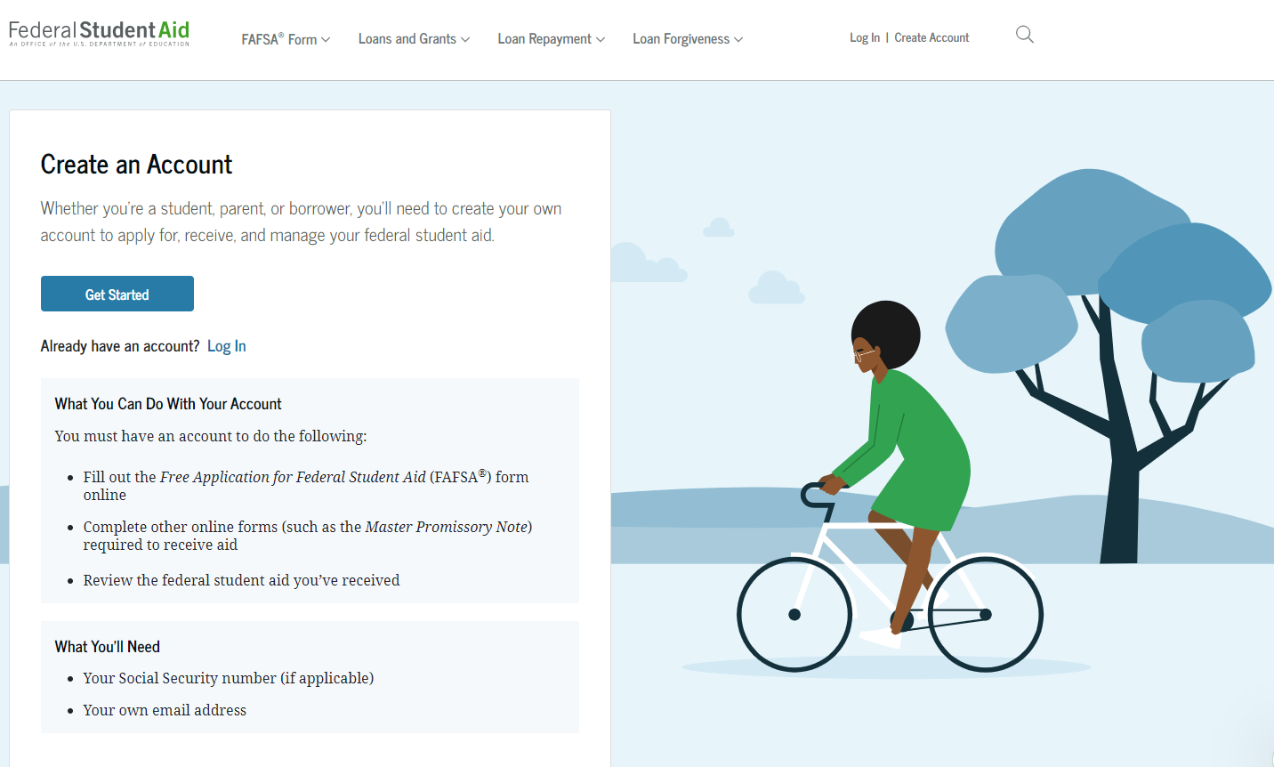
Studentaid.gov

Slide 9
Who needs an FSA ID?
INDEPENDENT STUDENTS STUDENTS:
Student
Student’s Spouse (if married)
DEPENDENT STUDENTS
Student
Parent and or Spouse/Stepparent
If parents are married and 2022 tax filing status is married filing jointly = 1 parent needs FSA ID
If parents are married, and 2022 tax filing status is anything other than joint = both parent/stepparent need FSA ID
If parents never married, but live under the same roof = both parent/stepparent need FSA IDs
If parents are married or never married living together, and did not file 2022 taxes = both parent/stepparent need FSA IDs
WHY IS THIS IMPORTANT?
Each contributor is required to complete their portion of the FAFSA and give “CONSENT” to use their information for financial aid purpose, does not indicate financial responsibility
No Consent, even if contributor tax information is entered manually = No Federal Student Aid

Slide 10
Dependency Status

Slide 11
Parents/Contributor
Beginning the 2024-2025 FAFSA, the parent who provides the MOST financial support is who goes on the FAFSA regardless of who the student lives with
When determining which parent to use, you only compare biological parent for the student
Once parent is chosen, stepparent income and demographics would also be needed (if parent is married)
If parents married but filed separate, then both parents will need to create an FSA ID and complete their specific portion of the FAFSA.
Both parents will need to be invited and provide consent
Full demographic is needed for both parents
Incomplete FAFSAs will be deleted after 45 days of no activity.
Current college students may be required to change which parent is reported in the FAFSA
Renewal FAFSA is not available for current college students for the 2024-2025 cycle only

Slide 12
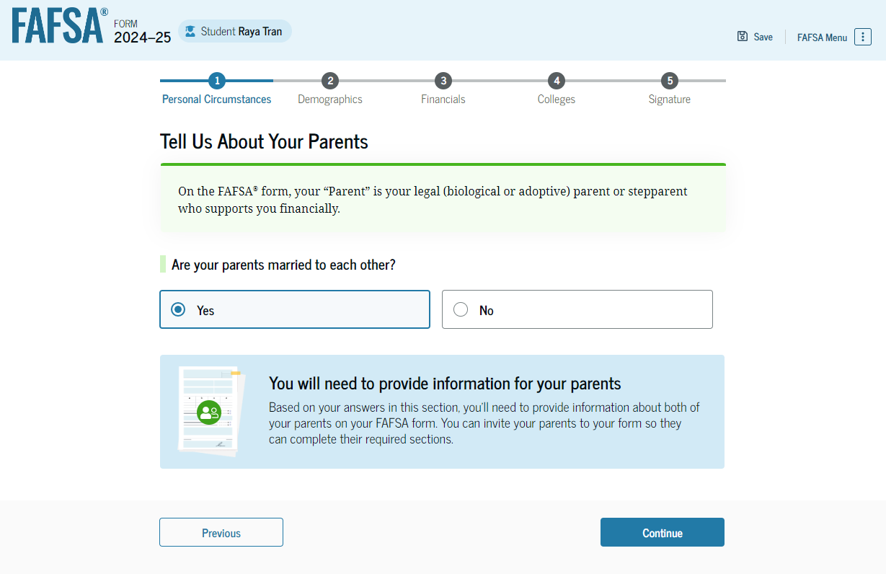
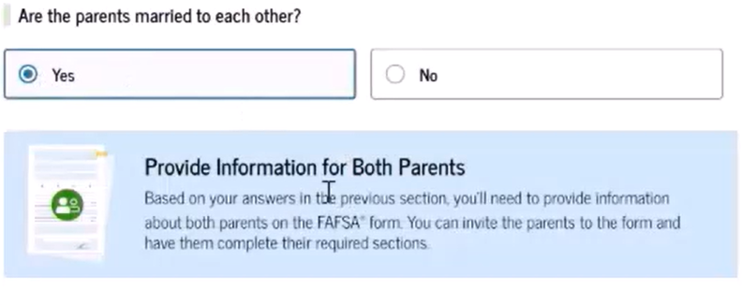
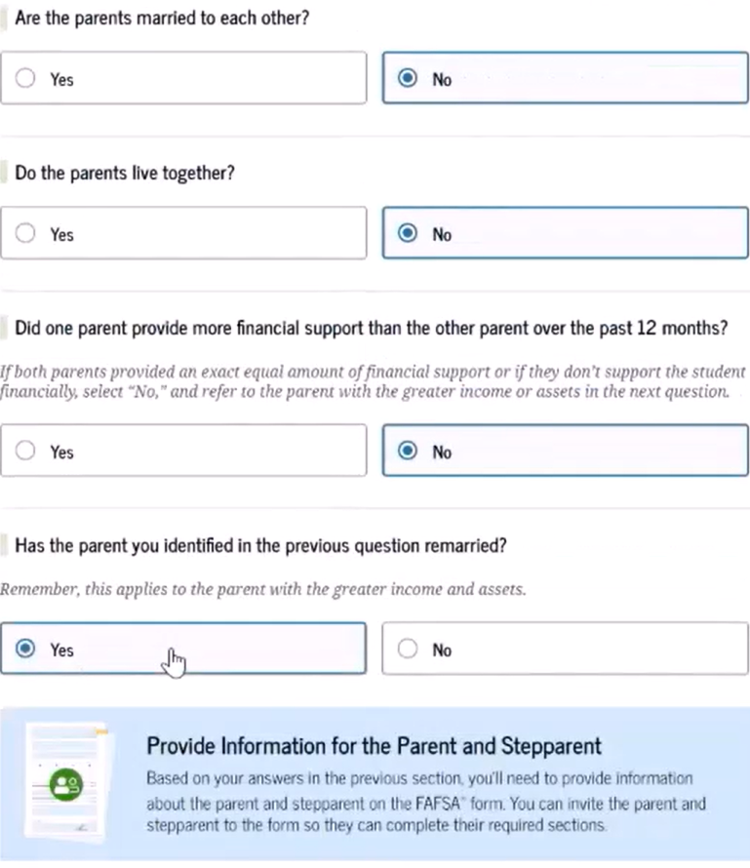
Which Parent – Parent Wizard
Interactive worksheet
Helps student to determine which parent(s) should be included on their FAFA form

Slide 13
Parents/Contributor (CONT.)
Contributor IS NOT:
Non-adoptive grandparents
Foster parents
Legal guardians
Brother/Sister
Aunts/Uncles
Even if they helped provide for or raise the student

Slide 14
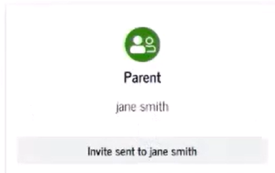
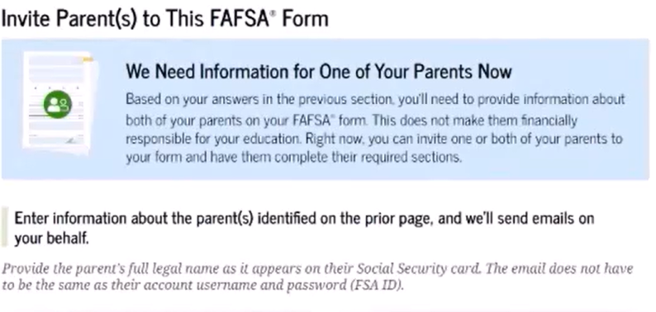
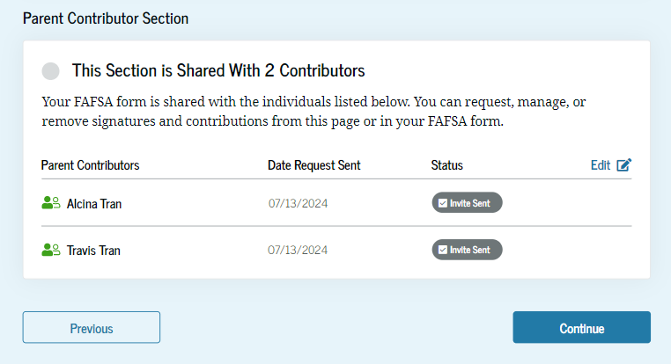
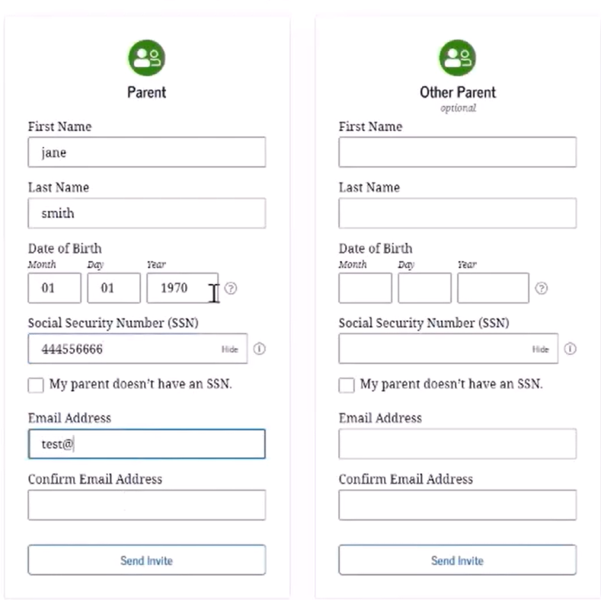
Invite Parent(s) to FAFSA form
Invite happens in real time, and parent can complete their information once they receive the email.
Student/parent must provide:
Legal first and last name
Date of birth
Social Security Number
Email
Student can continue to complete their information
If parent does not have an SSN, student will check box regarding no SSN
Student will then be prompted to enter a mailing address
Strict privacy restrictions, can only be used & share for federal financial aid calculation

Slide 15
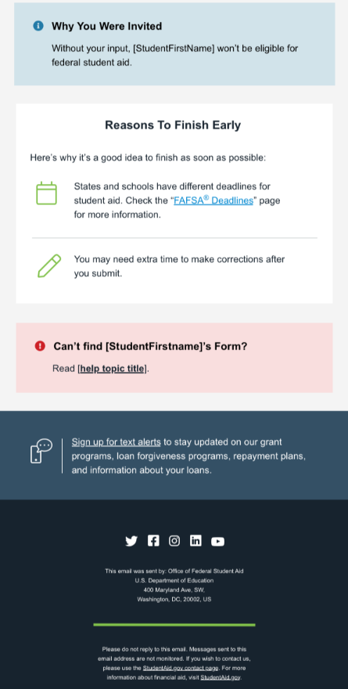
Contributor’s Notification

Slide 16
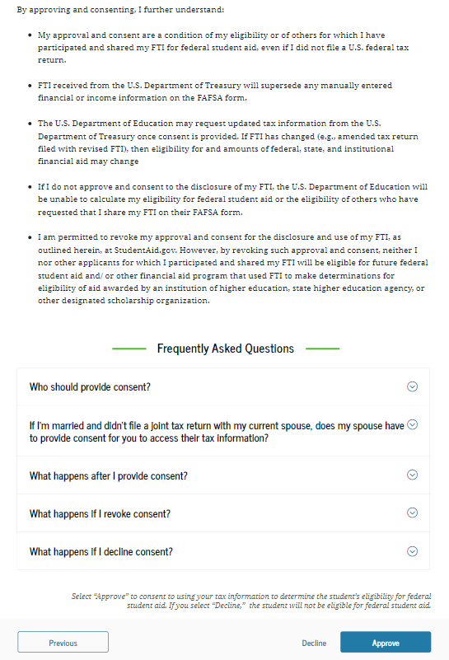
How does the Parent Provide “Consent”

Slide 17
Family Size
Beginning 2024-2025 award year
Student’s family size will align with the parent’s/contributor's prior-prior year federal tax return (2022 federal tax return for 24-25 FAFSA)
Family size will be calculated with the following data
When FTI is received: Student’s exemptions + Parent’s exemptions (if student is dependent), from IRS
When FTI is not received: Self-report family size
When family size has changed or is different from the number of individuals claimed on the prior-prior year federal tax return, there will be a question to report updated family size

Slide 18
What is FTI (Federal Tax Information)
FTI is:
Any return or return information received from the IRS or secondary source
Consists of tax data elements or information derived from tax returns
Data collected shall be used only for the application, award, and administration of financial aid
Systems that receive FTI must meet the Safeguard and Security requirements
Tax information manually supplied by taxpayers is NOT considered FTI by the IRS
Data received from the FA –DDX
(Future Act– Direct Date Exchange):
Tax Year
Tax filing status
Adjusted Gross Income (AGI)
Number of exemptions/dependents
Income earned from work
Taxes Paid
Educational credits
Untaxed IRS Distributions
IRA deductibles and payments
Tax exempt interest
Untaxed pension amounts
Schedule C net profit/loss
Indicators for tax schedules
IRS response code

Slide 19
Assets
There will be no asset question for families who:
Are eligible for max Pell grant (non-filers)
Make less than $60,000 and did not file a Schedule C
Filed a Schedule C, but is less than $10,000
Federal benefits recipient
If required to report assets, families will be required to report value of:
Net Worth of farm, even if family lives on the farm (only include net value of the working farm, not family’s primary residence, if located on the farm)
Net worth of business, even if the business has one employee
Net worth = Value of farm/business – debt owed
529/educational savings plans are only included that the student benefits from and is reported on the on the parent portion of the FAFSA
If someone other than the student/parent has taken out a 529 for said student, then that is NOT reported on the student’s FAFSA
Child support received is now listed as an asset and you report all received from the last calendar year.

Slide 20
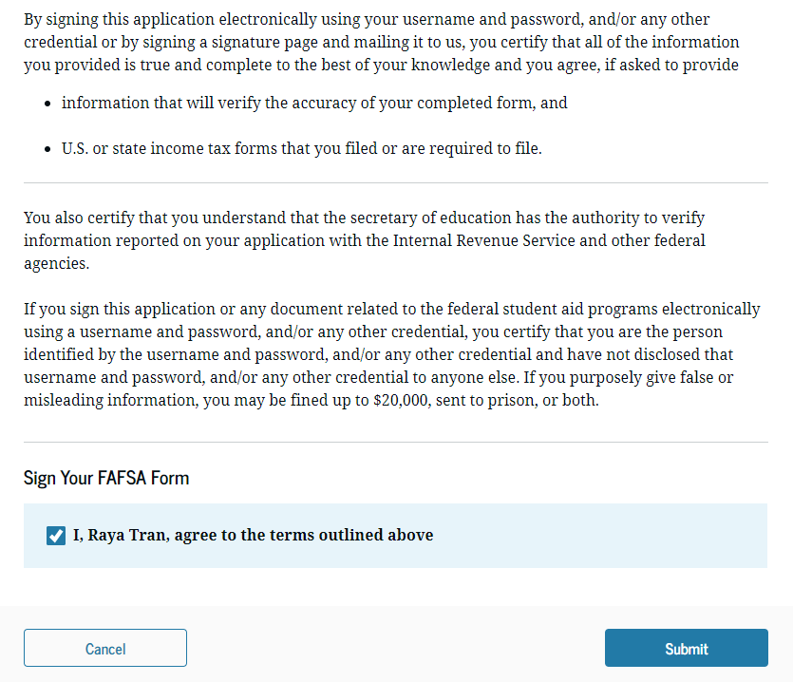
Student Signature Selection

Slide 21
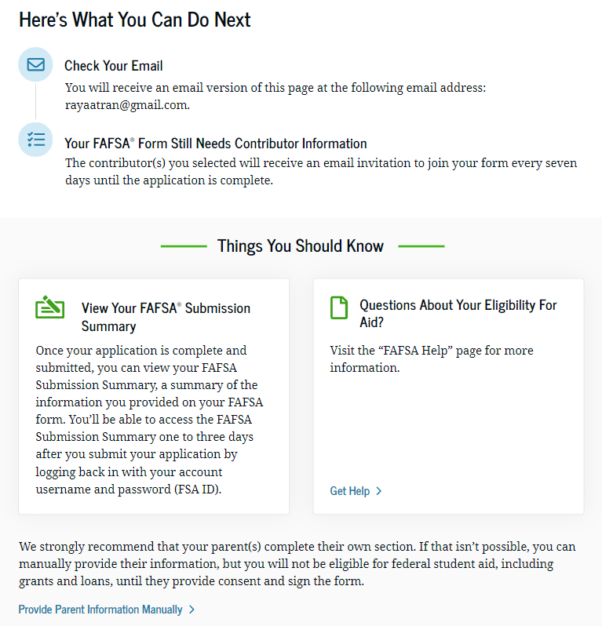
Student Submission Summary Notification

Slide 22
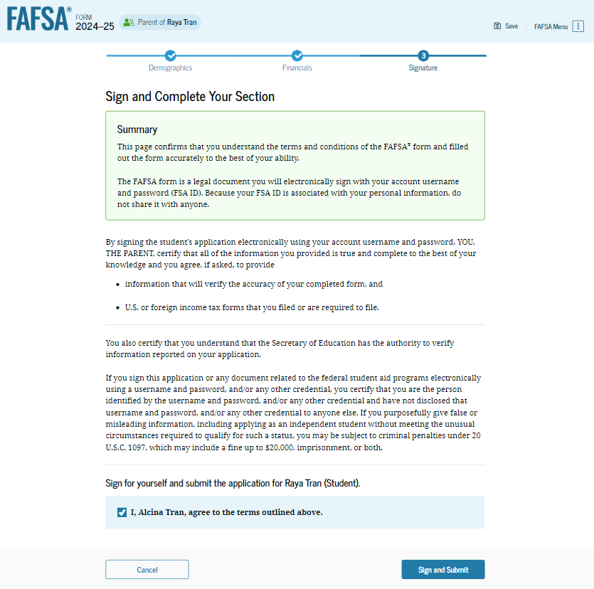
Parent Signature Correction

Slide 23
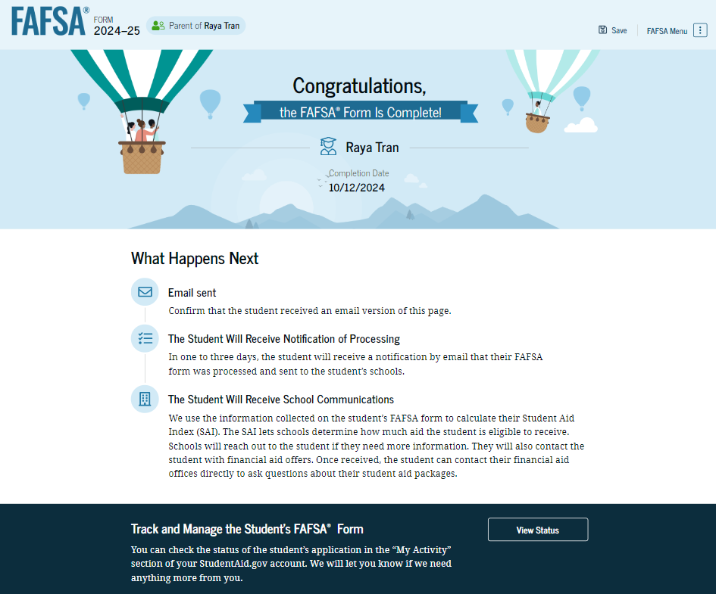
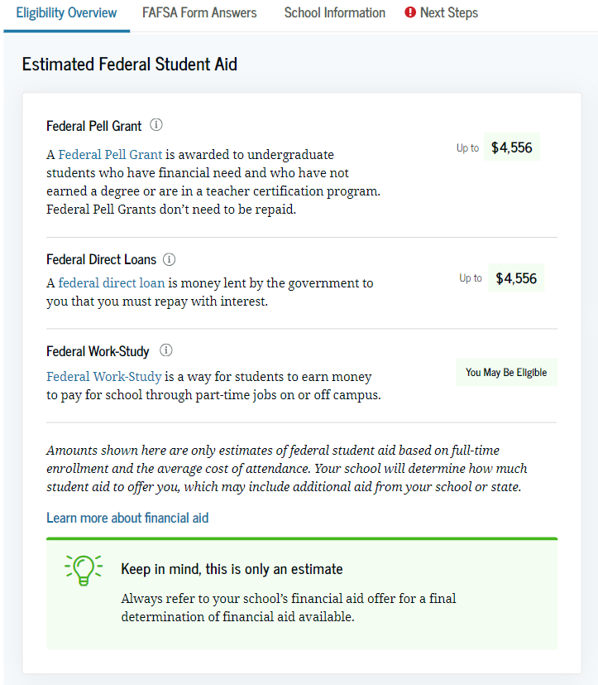
Once all signatures have been added
Available AFTER all contributors have submitted their parts of the application
Available by STUDENT ONLY logging into StudentAid.gov

Slide 24
Students and Parents can check the status

Slide 25
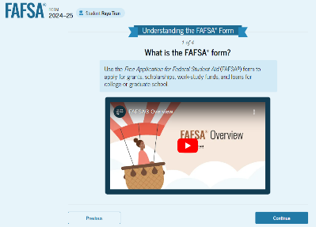
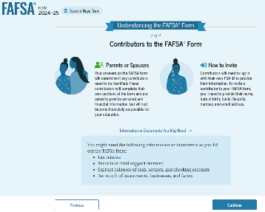
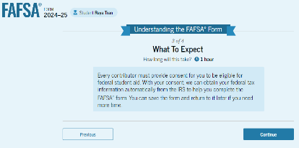
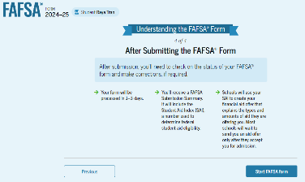
What is the process?
Create FSA ID Early
Onboarding process with initial log in
Student completes student portion
Invites parent via email to participate in their FAFSA
Parent logs on via link in email or studentaid.gov dashboard
FAFSA Submission Summary is in real-time with live updates and notifications
The last contributor entering information will have the option to submit

Slide 26
Student Aid Index (SAI)
Need Calculation = COA - SAI - OFA
Allows for negative SAI up to -1,500 instead of zero
Non-tax filers will be an automatic -1,500
Allows to identify Additional levels of need
Aid cannot exceed Cost of attendance
No proration of SAI for periods other than 9 months
Financial information will now mostly be provided from the future act- Direct data exchange (FA-DDX)
Cost of Attendance
Student Aid Index
Other Financial Aid

Slide 27
SAI: Allowances Against Income
Federal Work-Study Program – rather than the broader allowance against income for taxable earning from need-based employment that appears in the former EFC formula
Any Institutional Grant & Scholarship Aid included in the Adjusted Gross Income (AGI) on a federal tax return
American Opportunity or Lifetime Learning (Education) tax credit amounts claimed on the federal tax return
Payroll Tax Allowance, which replaces the Social Security Tax allowance from the EFC formula
Federal Income Tax paid, the employment expense allowance, and the income protection allowance (IPA)

Slide 28
Key Dates – Impacting Families
December 27, 2020: Consolidated Appropriations Act, 2021 signed into law; includes FAFSA Simplification Act
March 15, 2021: Consolidated Appropriations Act, 2022 includes technical revisions to the FAFSA Simplification Act including delaying implementation for FAFSA and SAI formula provisions to 2024-25
November 15, 2023: ED announces 2024-25 FAFSA will be available by December 31. Students will also be unable to make corrections to submitted FAFSAs until late January
December 15, 2023: ED announces FAFSA release will be a “soft launch”
December 30, 2023: FAFSA opens with significant outage periods and early reports of students unable to complete the application for various reasons
January 7, 2024: FAFSA Issue Alerts page created documenting many issues impacting applicants’ ability to complete the form, including students whose contributors (parents and students’ spouses) lack a social security number (SSN)
January 30, 2024: ED announces students will not be able to make corrections to submitted FAFSAs until the first half of March
March 12, 2024: ED announces that most contributors without an SSN can now complete their FAFSA section
March 15, 2024: As larger batches of ISIRs are received, schools report seeing higher than normal rates of students applying for unsubsidized loan only. ED later changed the wording of the FAFSA question to ensure students answer correctly
March 25, 2024: ED announces delay in applicants’ ability to make FAFSA corrections to the first half of April
March 29, 2024: ED catches up on FAFSA backlog

Slide 29
Key Dates Impacting Colleges/Universities
September 28, 2023: ED releases 3 ISIR test data files
November 15, 2023: ED announces delivery of ISIRs delayed to late January
January 30, 2024: ED announces ISIR delivery to schools and states will be further delayed to first half of March and will be sent in batches as part of a ramp-up strategy
February 15, 2024: ED releases 8 additional test ISIRs, not system-generated, not delivered via new FTI-SAIG mailbox
March 4, 2024: ED releases ISIR transmission plan with small ISIR batches anticipated to be sent in first half of March, ramping up to larger batches over the following days or weeks, and entire ISIR backlog transmitted within 2 weeks following ramp up
March 11, 2024: First small batch of ISIRs sent to limited number of schools
March 13, 2024: ED begins transmitting larger ISIR batches; majority of schools should receive at least 1 ISIR and many will receive dozens
March 25, 2024: ED announces reprocessing of ISIRs impacted by SAI formula issue that ignored dependent student assets will not take place until after corrections process opens
April 4, 2024: ED announces it will reprocess all ISIRs impacted by inaccurate IRS data transfer, beginning in the first half of April

Slide 30
Secretary Cardona’s Letter
Letter sent on March 15
Sent to college presidents
5.82 Million applications processed (as if 4/23/24: 7.9 Million)
Dedicated personnel to 300 schools – College Support Concierge mailbox
Reducing verification requirements and suspending program reviews until 6/24
Complete SAIG mailbox agreement and configure EDConnect
Extend decision dates

Slide 31
ISIR Reprocessing Woes
GENERAL-24-39
Will start reprocessing these files “in the coming weeks” (April 11)
You don’t have to wait! CSV file with UUIDs (University Unique Identifiers) to compare
Can use the original ISIR if 3 conditions are met:
ISIR is based on 24-25 FAFSA/aid is 24-25
Original ISIR results in greater financial aid eligibility for students (if reprocessed ISIR results in greater financial aid, schools may make estimates now but use the more accurate record for disbursement)
ISIR is subject to reprocessing due to one of the errors by ED

Slide 32
What are the ISIR reprocessing errors?
GENERAL-24-38
Pell Grant Eligibility Flag is blank – ISIR field 571
Pell Grant Eligibility Flag set to Y on ISIRs without an SAI – 571
Comment code 217 appearing incorrectly – (should be 327)
Dependent students with assets and blank SCA – missing assets
SAI blank on some ISIRS that do not contain reject codes
FTI missing from non-rejected ISIRS where FTI consent provided
Inconsistent tax data, Education Tax Credits
Inconsistent tax data, Amended and Updated Tax Returns
Inconsistent tax data, Schedule H indicator or other mismatch
Handling these on a case-by-case basis; document decision

Slide 33
ISIR Corrections
General -24-37
Students are now able to make corrections
16% of all records need a student correction (over 1 million)
The overwhelming majority of the required student corrections involve 6 issues
Four of these are that the form is missing:
Student signature
Parent’s signature
Consent and approval from the student to retrieve federal tax information (FTI)
Consent and approval from the parent to retrieve FTI
Two additional issues include dependent student’s choosing to only to be considered for eligibility for Direct Unsubsidized Loans or making selections on the form that place them in a provisionally independent status at historically high rates.
Repossessing – 30% affected by a known processing error (over 2 million)
School will get corrected ISIRS for inconsistences due to education tax credits, AGI amended tax returns by May 1.

Slide 34
When can schools correct ISIRS?
Hopefully beginning May 1

Slide 35
Secretary Cardona’s Letter
Letter sent on Tuesday, April 9
Sent to college presidents
More than 7 million applications filed
Students can now make corrections
We’ve identified the errors and have fixed those errors
Move forward in packaging
We’ve suspended program reviews, reduced verification, and moved back GE reporting

Slide 36
INDIVIDUALS WITHOUT AN SSN
GENERAL-24-19
Some fixes in place
Recommend the student start the application and invite the parent to contribute
Parents with no SSNs were receiving errors – “unauthorized to act on behalf of the student since they already have a 24-25 FAFSA form”
Other issues
All users must manually enter their FTI
If PII is mismatched, applicants and contributors get errors

Slide 38
Questions?

