Slide 1
Perkins Loans And Other Issues: Liquidation or Reauthorization?
Kentucky Association of Student Receivable Officers: Fall Workshop
October 25, 2018

Slide 2
Legal Disclaimer
The views and opinions expressed by the Presenter are those of the Presenter and not necessarily representative of the Coalition of Higher Education Assistance Organizations.
This information is not intended as legal advice and may not be used as legal advice. Please rely on the advice of your own legal counsel.
Every effort has been made to assure this information is up-to-date but circumstances constantly change.

Slide 3
Agenda
Perkins Wind-Down Guidance
Administrative Cost Allowance
Perkins Cohort Default Rate
Key Factors to Assessing your Portfolio
Perkins Assignment & Liquidation Process
Short-term Loan to the Fund
Summary and Recap
Resources
Questions

Slide 4
The 115th Congress
House
Senate
236 Republicans
193 Democrats
6 Vacancies
Majority controls agenda
Majority always rules unless it is divided
Which it often is!
51 Republicans
49 Democrats
Majority sets agenda
60 votes needed to move most legislation
Exception: “Budget Reconciliation”
Notes:
4

Slide 5
Everyone’s Talking Elections
All 435 House seats up this year.
One-third of the 100 Senate seats up – 34 this year.
This year, 26 Democrats (including two left of center independents), only 8 Republicans.
January 2019: New Congress takes office. House could change hands (55-45 it will), Senate probably not (30-70).

Slide 6
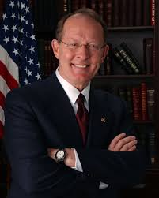
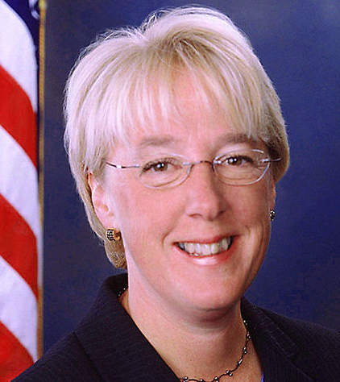
Key People In Congress (Now, Later)
Senate HELP Committee, 12 Republicans, 11 Democrats
(Health, Education, Labor and Pensions) Controls Higher Education Act
Key HELPers:
Sanders (I-VT)
Collins (R-ME)
Baldwin (D-WI)
Burr (R-NC)
Casey (D-PA)
Isakson (R-GA)
Bennet (D-CO)
Enzi (R-WY)
Kaine (D-VA)
New this Congress:
Doug Jones (D-AL)
Tina Smith (D-MN)
Todd Young (R-IN)
Maggie Hassan (D-NH)
Lamar Alexander (R-TN)
Patty Murray (D-WA)
Chairman
Ranking Democrat

Slide 7
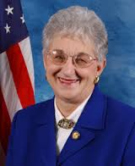
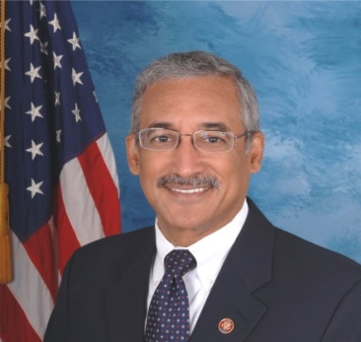
Key People In 115th Congress
House Education & Workforce Committee
Jurisdiction over Higher Education Act
22 R, 17 D
Some Key Members:
G.T. Thompson (R-PA)
Phil Roe (R-TN)
Jared Polis (D-CO)
Alma Adams (D-NC)
Chairwoman
Virginia Foxx (R-NC)
Ranking Member
Bobby Scott (D-VA)
Chairwoman Virginia Foxx (R-NC)
Ranking Member Bobby Scott (D-VA)
Subcommittee on Higher Education and Workforce Training
Chairman: Brett Guthrie (R-KY)
Ranking Democrat: Susan Davis (CA)
Changes likely to members, not most leaders.

Slide 8
Changes at Department of Ed
Chief Operating Officer:
Dr. Wayne Johnson leads new FSA Office of Strategy and Transformation
Jim Manning is Acting COO = key player for higher ed
Previously in many top roles
Next Gen: Next Generation Processing and Servicing Environment coming soon?
Will transform direct loan systems
Servicers taking steps to delay it or force major changes
RFP for pilot released last week

Slide 9
Office of Postsecondary Education
Diane Auer Jones: Delegated Duties of Assistant Secretary for Postsecondary Education and Undersecretary of Education
Administration plans to abolish Undersecretary post
Lynn B. Mahaffie: Deputy assistant secretary (career staff)
Linda Byrd-Johnson: Acting Deputy Assistant Secretary for Higher Education Programs
Gail McLarnon: Acting Deputy Assistant Secretary for Policy, Planning and Innovation – Retired
Brian Smith: Lead career staff on campus based issues
Daniel J. Miller: Deputy Assistant Secretary for Management and Planning

Slide 10
HEA Action in Congress
HEA reauthorization process activated in 2017 – House Education & Workforce Committee approved “PROSPER Act” in December
Chairwoman Foxx couldn’t get it through the House
Needs almost all Republicans since bill has no Democratic support – not there – action this year unlikely
House Democrats introduced “Aim Higher Act” in July; amalgam of bills introduced before – no action this year
Senate stalled; maybe a Republican bill introduced this year, but it won’t go anywhere
Senate Democrats issued set of general principles
Principle #1: We Hate House Republicans’ PROSPER Act

Slide 11
HEA in House – PROSPER Act
House bill: “PROSPER Act” Replaces Direct Loan Program with new Federal One Loan Program
No Perkins or SEOG, major changes to Direct Loan Program
No Grad PLUS, Parent PLUS capped,
Subsidized Direct loans eliminated for undergrads
Unsubsidized Direct limits raised to make up for loss of Perkins
Streamlines Repayment Plans
Standard 10-year, with longer periods permitted for consolidation loans
Income Derived: payments = 15% of discretionary income, but all principal and 10-years-worth of interest have to be repaid before forgiveness allowed
Increases Pell Grants -- $300 bonus if taking 15 credit hours
Eliminates Public Service Loan Forgiveness

Slide 12
PROSPER Act
Forces Ed to provide initial finding of program reviews within 90 days
Expands FWS with revised funding formula and eliminates graduate eligibility
Repeals Teach Grants, some other grant programs
Paychecks for Students
Credit balance refunds would be paid to student in equal monthly or weekly installments
Deposited on a debit card
First installment may be paid as early as 30 days before first day of classes, no later than 30 days after they start.

Slide 13
PROSPER Act
Risk Sharing and Accountability
Replace cohort default rate with loan repayment rate (calculated by program of study)
Programs where fewer than 45 percent of former students are making required payments could lose Title IV eligibility.
90-10 Rule repealed.
Gainful employment requirement repealed.
Tighten rules on “earned aid” under R2T4 for withdrawn students, so schools bear more cost.
Require schools to pay ED for portion of defaulted loans

Slide 14
Aim Higher Act
Introduced July 26 by E&W Ranking Dem. Bobby Scott (VA)
811-page bill generally keeps status quo on aid, unlike PROSPER, with some changes
Pell Grants maximum raised, indexed to inflation
Perkins Loan Program recreated along “unsubsidized Perkins” model proposed in Obama Administration; like unsubsidized Direct loans, federal loan servicing, nationwide volume limit. Open to modifying it.
Caps on Direct and PLUS loans unchanged
States required to make two years of college free

Slide 15
Aim Higher Act
Changes CDR calculations, makes 90-10 rule 85-15 and counts GI Bill funds same as Title IV.
Eliminates origination fees
Retains and expands Teach Grants, FWS
Simplifies repayment plans like PROSPER, but keeps forgiveness after 20 years, keeps PSLF.
Meant to be an alternative to PROSPER so not complete.
Won’t get hearing in House this year, but will be base of HEA proposal in 2019 if House majority changes

Slide 16
Contrasting Visions for Higher Ed

Slide 17
So, What Will Happen???

Slide 18
This?

Slide 19
Or This?

Slide 20
It Will Make A Difference
???

Slide 21
Update on Perkins Loans 2018
Despite much support, Perkins remains expired
H.R. 2482 – Introduced on 5/17/17 – two year extension through 9/30/19.
253 cosponsors, a majority of the 435 members of the House of Representatives – 51 Rs and 192 Ds.
S. 1808 – Introduced 9/14/17 – same as House bill. 22 cosponsors -- 4 Rs and 18 Ds.
Not sponsoring: House Education and the Workforce Committee Chairwoman Virginia Foxx (R-NC); Senate HELP Committee Chairman Lamar Alexander (R-TN) This is most unfortunate!
21

Slide 22
It’s Not Over!
Just because the program has expired doesn’t mean it can’t be resurrected.
A lot of campus money remains on the table.
COHEAO will work to ensure institutions receive the money they are due.
ED should permit campuses to retain their share of unreimbursed cancelled loans.
Also, there is a need for ACA to be paid to support school servicing!

Slide 23
Perkins 2.0 – 21st Century Perkins
COHEAO proposal for HEA Reauthorization includes a new Perkins Loan Program:
New federal funds replace revolving loan funds
School match – level to be determined
Updates the allocation formula, phases out the base guarantee
No in-school interest
No origination fees and low interest
Maintains cancellations for public service
Servicing remains school based

Slide 24
Perkins Wind Down Issues

Slide 25
DCL GEN-17-10: Perkins Wind-Down Instructions
Institutions are not required to assign their Perkins loans or liquidate their portfolio.
Institutions may continue servicing their Perkins Loans until all loans paid in full, retired or assigned
Institutions may liquidate at any time and may assign defaulted or non-defaulted Perkins loans at any time.
The institution loses all rights to assigned loans and will not receive any share of future funds collected.
Institutions that continue servicing their Perkins Loan portfolios must continue to service in accordance with the regulations and report the portfolio on the FISAP.

Slide 26
July 11, 2018: Distribution of Assets
The Distribution of Assets process replaces the previous excess cash process.
ED will require a capital distribution from institutions’ Perkins funds annually through G5 (or successor).
Institutions will receive a notification with the amount of federal and institutional share that must be returned/removed and the deadline for doing so.
Notification to schools in December this year
Higher Ed Groups Asking For Delay
Institutional share may be used for any purpose
Schools may ask for adjustment if return creates a shortfall
Proportional share calculation comes from recent FISAP

Slide 27
Distribution of Assets Proportional Share Calculation
Cash on Hand in the Perkins Fund (FISAP, Part III, Sec A, Line 1.1)
Proportional Share Percentage:
Total Net FCC (Federal Capital Contribution)
Total FCC minus Repayments of FCC to the Department
Total Net ICC (Institutional Capital Contribution)
Total ICC minus Repayments of ICC to the institution
Federal Share Percentage = $\frac{Net FCC}{Net FCC+Net ICC}$
Institutional Share Percentage = $\frac{Net ICC}{Net FCC+Net ICC}$
Federal Share to be Returned to the Department is the total Cash on Hand multiplied by the Federal Share Percentage
Institutional Share to Be Returned to the Institution is the total Cash on Hand multiplied by the Institutional Share Percentage
= 100%

Slide 28
October 4, 2018: Perkins Administrative Responsibilities & Reporting Requirements
Schools who service their Perkins portfolio must service the loans according to the program rules:
Due Diligence (34 CFR 674.41(b))
Use of contractors for billing and collection (34 CFR 674.48)
Collection procedures (34 CFR 674.45)
Ceasing Collections (34 CFR 674.47)
NSLDS (34 CFR 674.16(j))
Report timely and accurately
Include enrollment data for each loan
Ensure borrower loan information is accurate and current; especially for Perkins assignment purposes
Request a reconciliation report from NSLDS - reconcile any discrepancies

Slide 29
Administrative Cost Allowance

Slide 30
Administrative Cost Allowance
June 30, 2018 is last date for charging ACA to the Perkins fund
ACA is the key to sustaining quality campus-based servicing and institutions should be compensated.
The institution:
has the incentive and ability to collect more
has a vested interest in how the loans are serviced
won’t be forced to liquidate due to administrative costs
can maximize the recovery of its ICC investment
Mass assignments may result in delays, errors and harm to borrowers. Having schools service is a win-win!

Slide 31
Replacement for ACA
COHEAO advocated for a change in the law and Congress recently passed a spending bill that provides ED with the authority to pay schools that service their Perkins loans:
“…funds appropriated under this heading may be available for payments for student loan servicing to an institution of higher education that services outstanding Federal Perkins Loans under part E of title IV of the Higher Education Act of 1965…”

Slide 32
Cancellation Reimbursement Efforts
COHEAO, NASFAA, & ACE are advocating on behalf of schools for ED to repay the institutional share of unreimbursed cancellations – as required by Higher Education Act.
ED has acknowledged its obligation to reimburse schools – but claims they have been unable to do so because of the lack of Congressional appropriations.
Congress Agrees – schools are owed cancellation share
NASFAA & ACE wrote to ED urging them to reimburse institutions for cancelled Perkins Loans
Stated the failure of Congress to appropriate funds does not absolve ED from meeting its statutory obligation under the law.
Suggested that ED delay upcoming notification to schools regarding the return of FCC until they resolve this issue.

Slide 33
Senate Appropriations Committee:
“Colleges and universities participating in the Perkins Loan Program have provided loan cancellation to eligible borrowers under 20 U.S.C. 1087ee(a). Given the wind-down of the program, the Secretary is set to outline the process for distributing assets from institutions’ student loan funds established under 20 U.S.C. 1087ff later this year. The Committee encourages the Secretary to use any authority granted for reimbursing colleges and universities for cancelled loans for which no reimbursement has been provided and directs notification of the Committees on Appropriations of the House of Representatives and the Senate and Committee on Education and the Workforce of the House of Representatives and Senate Health, Education, Labor and Pensions Committee not late than 10 days prior to any such reimbursement.
The Committee recommendation also includes new bill language allowing funds appropriated under the Student Aid Administration account to be used for making payments to institutions of higher education for servicing Federal Perkins Loans.”

Slide 34
ACA and Cancellation Reimbursement
What you can do to help advocate for the ACA and cancellation reimbursement actions:
Calculate what is owed to your school using the FISAP
If you have a plan for using ICC for student aid, write that up
Educate your government relations and upper administration personnel about how much money is at stake.
Reach out to Members of Congress
Let them know the plan for the money, if possible
Share this information with colleagues!
34

Slide 35
Deciding What To Do Now
What is the value of your Institution’s Investment in Perkins
What are the benefits of servicing
How to project future revenue
Maximizing your recoveries
Identifying the cost of servicing
What are the costs and risks of liquidation

Slide 36
1. Calculate Your Investment
Calculate your institution’s share of the Perkins Fund using the following 2017 FISAP data:
Total Net FCC (Federal Capital Contribution)
Total FCC minus Repayments of FCC to the Department
Total Net ICC (Institutional Capital Contribution)
Total ICC minus Repayments of ICC to the institution
Federal Share Percentage = $\frac{Net FCC}{Net FCC+Net ICC}$
Institutional Share Percentage = $\frac{Net ICC}{Net FCC+Net ICC}$
Apply the Institutional Share % to your cash on hand and outstanding loan balance to determine your share of the fund

Slide 37
Cost Factors
Identify the Cost to Service your Perkins Loans:
Fixed vs. variable costs
Fixed: salaries, maintenance fees, reporting fees to credit bureau, rent, NSLDS, etc.
Variable: per-borrower billing costs, postage, phone calls, skip-tracing, Clearinghouse
Where can costs be reduced
Natural decline in billing costs, e-signature, postage
Utilize your recovery forecast and paid-in-full averages to estimate account volume
Salaries: staff attrition, cross training for other areas

Slide 38
7 Reasons to Continue Servicing….
Recover your institution’s investment (ICC).
Utilize the ICC to fund an institutional loan program or provide additional aid to students.
Foster the borrower/alumni relationship.
Convert as many loans to paid-in-full as possible (fewer loans to assign in the future = less work and less liability).
Clean up and/or reconcile your Perkins portfolio first
Rejected loans in liquidation result in a cost to the campus – must buy the loan if you can’t resolve but rejected loans in an assignment do not result in a cost – you can continue to service the loan.
Jobs retained.

Slide 39
NACUBO White Paper

Slide 40
Decision Tree for Assigning Individual Loans
From NACUBO Advisory Guidance

Slide 41
ED Guidance on Short-Term Loans to the Fund
A school previously had the ability to deposit into its Perkins Fund as additional ICC, short-term, no interest loans to increase the Fund balance available for making Perkins Loans (often referred to as “overmatch”).
Beginning with the 2008-09 FISAP, new lines were added for schools to report these loans.
For a school to reclaim the additional ICC that was deposited from 2008-09 forward, the ICC must have been entered as a short-term, no interest loan made to the Fund.
A school may repay itself for a short-term loan to the Fund at any time using the lines that were added to the FISAP to reflect the repayment of such short-term, no interest loans.
ED did not define what it considered as "short-term”.

Slide 42
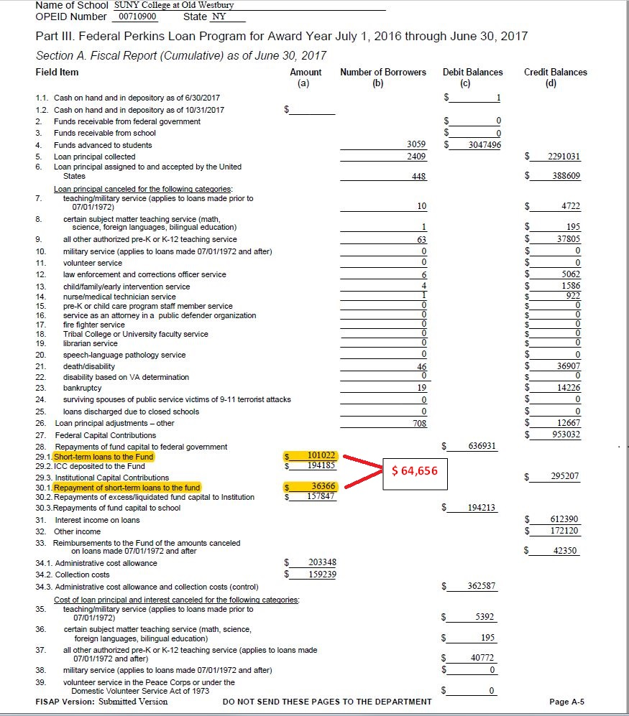
Short-Term Loans to the Fund

Slide 43
Short-Term Loans to the Fund
Calculate the difference between lines 30.1 and 29.1
Repay your institution in full by increasing the amount on line 30.1 by the difference.
Remove that amount from the fund – repay your institution.
Line 30.1 will then be the same as the amount on line 29.1.

Slide 44
In Summary…
Evaluate your Perkins Portfolio
What are the costs and benefits of servicing
What are the risks and benefits of liquidation
What is the long-term projection for return on investment
Communicate with decision-makers on campus
Discuss costs, benefits, risks and resources
Maximize Returns and your ICC Recovery
Recirculate accounts to your collection agencies
Maximize the ability to reinvest into an Institutional Loan Program or 21st Century Perkins Loan Program
Support the operational costs of servicing the program
Pay yourself back for any overmatch (i.e short-term loans to the fund).
Monitor your cohort default rate!

Slide 45
In Summary…
Minimize Risk: Clean up your Portfolio before Liquidation
Assign older uncollectible loans first
Review your due diligence procedures and documentation
Review and document your electronic signature process
Reconcile NSLDS
Communicate your Post-Perkins resource challenges to your Congressional Representatives and/or COHEAO – enrollment, retention, financing
Utilize COHEAO as a resource for your compliance and training needs – http://www.coheao.org

Slide 46
Moving Forward Post-Perkins
There is bi-partisan support for restoring Perkins in Congress;
If Democrats win House, will propose it.
Until them: how to replace lost Perkins funds for students?
Institutional share of Perkins funds can be used for any purpose
Can at least partially replace Perkins with an institutional loan program using collected institutional share
Can also attract funds from donors or make arrangements with third-party lenders
COHEAO has new Institutional Loan Task Force to explore solutions and best practices
For more information contact Harrison Wadsworth

Slide 47
SAVE THE DATE!
2019 COHEAO Annual Conference
Washington D.C.
January 28 – 30, 2019

Slide 48
Become a Member of COHEAO
Membership Benefits:
3 FREE Webinars per year
Regulatory & Legislative Updates – Torch & Sparks
Lead organization on Perkins advocacy
A LOT More than Perkins:
Advocacy and training on legal and compliance issues that impact you and your institution directly
TCPA & CFPB Compliance
Student Tuition and Accounts Receivable (STAR),
Institutional Loan Task Force
Financial Wellness – Newsletters, Training, Whitepapers
A Voice on Capitol Hill – Advocacy and Relationships
Institutional membership rates are very affordable: $210 - $595 based on FTE (10% discount when you join within 30 days of this presentation).

Slide 49
Resource Links
IFAP Announcement 10/4/18: Federal Perkins Loan Program Administrative Responsibilities and Reporting Requirements: https://ifap.ed.gov/eannouncements/100418PerkinsLoanAdminiResponsibilitiesReportingRequirements.html
IFAP Announcement – Federal Perkins Loan Revolving Fund Distribution of Assets and Timelines for 2018-19:
https://ifap.ed.gov/eannouncements/071118CBPerkinsLoanRevolFundDistributionOfAssets1819.html
Dear Colleague Letter: GEN-17-10 Perkins Loan Extension Act of 2015: https://ifap.ed.gov/dpcletters/GEN1710.html
Federal Perkins Loan - Assignment and Liquidation Guide: https://ifap.ed.gov/cbpmaterials/attachments/PerkinsAssignmentandLiquidationGuide.pdf
Perkins Loan Assignment System (PLAS): https://ifap.ed.gov/eannouncements/attachments/092115PerkinsLoanAssignmentSystemSystemAvailandUserAccessInfoAttach.pdf
Federal Perkins Loan FAQs https://ifap.ed.gov/cbp/PerkinsFAQ.html

Slide 50
Contact Information
Harrison Wadsworth
Executive Director, COHEAO
Principal, Bose Washington Partners
202-349-2303 hwadsworth@bosewashingtonpartners.com
Jared Solomon
Associate Director, COHEAO
Assistant Vice President, Bose Washington Partners
202-289-3910 jsolomon@bosewashingtonpartners.com
Greg Marak
Director of Publications and Membership, COHEAO
Public Policy Specialist, Bose Washington Partners
202-289-3910 gmarak@bosewashingtonpartners.com

